Slide 1
Flu32/32B Strain Selection

Slide 2
Objectives
Hypothesis: Given that antigenic properties are a manifestation of hemagglutinin glycoprotein structure then the antigenic distance between two viruses can be predicted based on the amino acid differences.
Goal: Select contemporary strains that would challenge the antigenic distance prediction capabilities of the model
Strains should be within the same clade
Notes:
This is technically incorrect. Antigenic properties are a manifestation of combined HA, NA, and maybe M2 structures. What is truly being predicted are results of an HI, which are based on HA glycoprotein structure.

Slide 3
Summary of results
 | Antigen | Antiserum | Class | Identity | MDS method prediction | Raw HI prediction | Lab measure HI distance | MDS method error | Raw HI error
FLU32
 | A/swine/Indiana/A02430356/2019|2010.2 | A/Hong_Kong/4801/2014 | near id|near au | 96.0% | 1.44 | 2.4 | 4 | 2.56 | 1.6
 | A/swine/North_Carolina/A02219753/2017 | A/swine/Minnesota/A01280592/2013 | near id|far au | 97.1% | 5.25 | 2.7 | 3.5 | 1.75 | 0.8
 | A/swine/Iowa/A01729543/2016 | A/Beijing/32/1992 | far id|near au | 85.7% | 1.34 | 5.3 | 5.5 | 4.16 | 0.2
 | A/swine/Virginia/A02478738/2019 | A/swine/Iowa/A01480656/2014 | far id|far au | 83.4% | 7.26 | 5.3 | 8 | 0.74 | 2.7
 | A/swine/Oklahoma/A02218159/2017 | A/Hong_Kong/4801/2014 | near id|near au | 97.9% | 1.77 | 1.2 | 3 | 1.23 | 1.8
FLU32B
 | A/swine/Nebraska/A01672826/2017|C_IVA | A/swine/Indiana/A00968373/2012|C_IVA | near id|near au | 99.1% | 0.9 | 0.16 | 0.5 | 0.4 | 0.34
 | A/swine/Indiana/A02214844/2017|C_IVA | A/swine/Iowa/A01480656/2014|C_IVA | near id|far au | 98.5% | 3.7 | 3.3 | 4 | 0.3 | 0.7
 | A/swine/North_Carolina/A01732197/2016|C_IVA | A/swine/Pennsylvania/A01076777/2010|C_IV | far id|near au | 93.9% |  | 0.76 | 2.5 |  | 1.74
 | A/swine/Iowa/A01733626/2016|C_IVA | A/swine/Indiana/A01202866/2011|C_IVC | far id|far au | 91.2% | 7.3 | 6.33 | 6.5 | 0.8 | 0.17
 | A/swine/North_Carolina/A01732197/2016|C_IVA | A/swine/Minnesota/A01280592/2013 | far id|near au | 94.8% |  | 1.2
*This predicted negative antigenic distances. The absolute values were used, this logic needs to be checked.
Distances in retestset_final.csv, pred_ciavascreen.csv

Slide 4
Flu32
This study used MDS prediction. Training distances were extracted from ACMACS.

Slide 5
Feature Importance Index by position (seed = 777)
identity | 0.13 | 11at | 0.00 | 49ds | 0.00 | 78es | 0.00 | 92kr | 0.00 | 122pq | 0.00 | 131st | 0.00 | 137hs | 0.00 | 144gi | 0.00 | 156ks | 0.00 | 160at | 0.00 | 173qx | 0.00 | 189en | 0.00 | 193ar | 0.00 | 203ai | 0.00 | 219fs | 0.00 | 244fl | 0.00 | 273qs | 0.00 | 281cf | 0.00
1qr | 0.00 | 12tx | 0.00 | 49gs | 0.00 | 78gs | 0.00 | 92rt | 0.00 | 122dt | 0.00 | 131as | 0.00 | 137hn | 0.00 | 144gs | 0.00 | 156nq | 0.00 | 160kt | 0.00 | 173dq | 0.00 | 189gq | 0.00 | 193ky | 0.00 | 203at | 0.00 | 220iv | 0.00 | 246ns | 0.00 | 273hq | 0.00 | 282it | 0.00
2dn | 0.00 | 15lr | 0.00 | 50gr | 0.01 | 78ns | 0.00 | 93at | 0.00 | 122nx | 0.00 | 131es | 0.00 | 137hy | 0.00 | 144kv | 0.00 | 156qs | 0.00 | 160qt | 0.00 | 173kn | 0.00 | 189qr | 0.00 | 193ny | 0.00 | 204iv | 0.03 | 220ik | 0.00 | 246sx | 0.00 | 273hs | 0.00 | 282iv | 0.00
2kn | 0.00 | 20gv | 0.00 | 50gk | 0.00 | 78en | 0.00 | 94fh | 0.00 | 122dn | 0.00 | 133dn | 0.02 | 138at | 0.00 | 144ds | 0.00 | 156en | 0.00 | 160kq | 0.00 | 173kx | 0.00 | 189nr | 0.00 | 193af | 0.00 | 207qr | 0.00 | 220kv | 0.00 | 246nt | 0.00 | 273hp | 0.00 | 282tv | 0.00
2dk | 0.00 | 21pq | 0.00 | 50eg | 0.00 | 78dn | 0.00 | 94hy | 0.00 | 122qx | 0.00 | 133ds | 0.00 | 138st | 0.00 | 144ai | 0.00 | 156er | 0.00 | 160kr | 0.00 | 173nx | 0.00 | 189kn | 0.00 | 194il | 0.00 | 207kq | 0.00 | 220kr | 0.00 | 246tx | 0.00 | 273pq | 0.00 | 287ns | 0.00
3fr | 0.00 | 21qs | 0.00 | 50kx | 0.00 | 78dg | 0.00 | 94fy | 0.00 | 122px | 0.00 | 133dg | 0.00 | 138as | 0.01 | 144av | 0.00 | 156hr | 0.00 | 160rt | 0.00 | 173nq | 0.00 | 189eq | 0.00 | 196ai | 0.01 | 207kr | 0.00 | 220rv | 0.00 | 246st | 0.00 | 275ds | 0.00 | 289ps | 0.01
3il | 0.00 | 21ps | 0.00 | 50er | 0.01 | 78eg | 0.00 | 95ns | 0.00 | 122nq | 0.00 | 133es | 0.00 | 140it | 0.00 | 144an | 0.00 | 156eh | 0.00 | 160ar | 0.00 | 173qr | 0.00 | 189eg | 0.00 | 196it | 0.00 | 208iw | 0.00 | 220ir | 0.00 | 246nx | 0.00 | 275gs | 0.00 | 290hn | 0.00
3fi | 0.00 | 25fl | 0.00 | 50kr | 0.00 | 78ds | 0.00 | 96dn | 0.00 | 124gn | 0.00 | 133de | 0.00 | 140rt | 0.00 | 144dv | 0.01 | 156hs | 0.00 | 160aq | 0.00 | 173dr | 0.00 | 189es | 0.00 | 196iv | 0.00 | 208ks | 0.00 | 222rw | 0.04 | 247rs | 0.00 | 275de | 0.00 | 291dg | 0.00
3ir | 0.00 | 25ls | 0.00 | 50ex | 0.00 | 78de | 0.00 | 101fy | 0.00 | 124dr | 0.00 | 133gs | 0.00 | 140kr | 0.01 | 144as | 0.00 | 156qr | 0.00 | 160qr | 0.00 | 173rx | 0.00 | 189nq | 0.00 | 196av | 0.00 | 208rw | 0.00 | 223av | 0.00 | 248nt | 0.00 | 275es | 0.00 | 292kr | 0.00
3fl | 0.00 | 25il | 0.01 | 50ek | 0.00 | 79fl | 0.00 | 101dy | 0.00 | 124gs | 0.00 | 133gn | 0.00 | 140ik | 0.00 | 144kn | 0.00 | 156hn | 0.01 | 160ak | 0.00 | 173kq | 0.00 | 189gn | 0.00 | 196at | 0.00 | 208gw | 0.00 | 223iv | 0.00 | 250dn | 0.00 | 275dg | 0.00 | 299kr | 0.00
3lr | 0.00 | 25fi | 0.00 | 50gx | 0.00 | 80kq | 0.00 | 101df | 0.00 | 124is | 0.00 | 133en | 0.00 | 140ir | 0.00 | 144eg | 0.00 | 156ek | 0.00 | 163ae | 0.00 | 173kr | 0.00 | 189gr | 0.00 | 196tv | 0.00 | 208ir | 0.00 | 223ai | 0.00 | 259kr | 0.00 | 275eg | 0.00 | 300iv | 0.00
5eg | 0.00 | 25fs | 0.00 | 50rx | 0.01 | 81dn | 0.00 | 105hy | 0.00 | 124di | 0.00 | 133ns | 0.00 | 140kt | 0.00 | 144de | 0.00 | 156rs | 0.00 | 163at | 0.00 | 173dx | 0.00 | 189kr | 0.00 | 197kr | 0.00 | 208rs | 0.00 | 224kr | 0.00 | 259qr | 0.00 | 276ek | 0.00 | 302fy | 0.00
5gr | 0.00 | 25is | 0.00 | 51lm | 0.00 | 82ar | 0.00 | 106as | 0.00 | 124ns | 0.00 | 133eg | 0.00 | 142gn | 0.00 | 144gk | 0.00 | 156kq | 0.00 | 163tv | 0.00 | 173dn | 0.00 | 189gk | 0.00 | 197hk | 0.00 | 208is | 0.00 | 225dn | 0.00 | 259kq | 0.00 | 276st | 0.00 | 304dv | 0.00
5er | 0.00 | 29il | 0.00 | 51il | 0.00 | 82nr | 0.00 | 106sv | 0.00 | 124nr | 0.00 | 135as | 0.00 | 142es | 0.00 | 144ag | 0.00 | 156hk | 0.00 | 163ev | 0.00 | 173nr | 0.00 | 189ks | 0.00 | 197qr | 0.00 | 208gs | 0.00 | 225dg | 0.00 | 260im | 0.01 | 276et | 0.00 | 304tv | 0.00
6gs | 0.00 | 31dn | 0.00 | 51im | 0.00 | 82et | 0.00 | 106av | 0.00 | 124dg | 0.00 | 135gs | 0.00 | 142gs | 0.00 | 144sv | 0.00 | 156kr | 0.00 | 163et | 0.00 | 173dk | 0.00 | 189qs | 0.00 | 197hr | 0.00 | 208gi | 0.00 | 225gn | 0.00 | 260lm | 0.00 | 276en | 0.00 | 304dt | 0.00
6rs | 0.00 | 31gn | 0.00 | 53ns | 0.00 | 82en | 0.00 | 107st | 0.01 | 124rs | 0.00 | 135es | 0.00 | 142gk | 0.00 | 144ik | 0.00 | 156es | 0.00 | 163av | 0.00 | 175dn | 0.00 | 189er | 0.00 | 197hq | 0.00 | 208ik | 0.00 | 226il | 0.00 | 260il | 0.00 | 276kt | 0.00 | 304at | 0.00
6gi | 0.00 | 31dg | 0.00 | 53ds | 0.00 | 82ae | 0.00 | 111il | 0.00 | 124ir | 0.00 | 135kt | 0.00 | 142en | 0.00 | 144ad | 0.00 | 156kn | 0.00 | 164lq | 0.00 | 177lm | 0.00 | 189kq | 0.00 | 197kq | 0.00 | 208gk | 0.00 | 226lv | 0.00 | 261kq | 0.00 | 276nt | 0.01 | 304av | 0.00
6nr | 0.00 | 32de | 0.00 | 53dn | 0.00 | 82er | 0.00 | 112av | 0.00 | 124gi | 0.00 | 135ks | 0.00 | 142ek | 0.00 | 144in | 0.00 | 157ls | 0.00 | 165es | 0.00 | 179iv | 0.00 | 189gs | 0.00 | 198as | 0.00 | 208sw | 0.00 | 226qv | 0.00 | 261qr | 0.00 | 276kn | 0.00 | 304ad | 0.00
6in | 0.00 | 33qr | 0.00 | 54rs | 0.00 | 82kr | 0.00 | 112ai | 0.00 | 124dn | 0.00 | 135st | 0.00 | 142ks | 0.00 | 144iv | 0.00 | 157lm | 0.00 | 165en | 0.00 | 182iv | 0.00 | 189ns | 0.00 | 198st | 0.00 | 208kr | 0.00 | 226iq | 0.00 | 261kr | 0.00 | 276ks | 0.00 | 307kr | 0.00
6is | 0.00 | 34iv | 0.00 | 54nr | 0.00 | 82kn | 0.00 | 112iv | 0.00 | 124gr | 0.00 | 135ag | 0.00 | 142gr | 0.00 | 144ak | 0.00 | 157ms | 0.00 | 165ns | 0.00 | 183hl | 0.00 | 190de | 0.00 | 198et | 0.00 | 208gr | 0.00 | 226iv | 0.00 | 262gt | 0.00 | 276ns | 0.00 | 309iv | 0.00
6gn | 0.00 | 38ns | 0.00 | 54ns | 0.00 | 82rt | 0.00 | 114as | 0.00 | 124in | 0.00 | 135ae | 0.00 | 142eg | 0.00 | 144dk | 0.00 | 158kn | 0.00 | 165kn | 0.00 | 185pt | 0.00 | 192ai | 0.00 | 198at | 0.00 | 208kw | 0.00 | 226lq | 0.00 | 262gs | 0.00 | 276es | 0.00 | 310kr | 0.00
6ir | 0.00 | 45gs | 0.00 | 56hy | 0.00 | 82at | 0.00 | 117ns | 0.00 | 124ds | 0.00 | 135gt | 0.00 | 142kn | 0.00 | 144dg | 0.00 | 158ek | 0.00 | 165ek | 0.00 | 186eg | 0.00 | 192at | 0.00 | 198ae | 0.00 | 209ns | 0.00 | 227ps | 0.01 | 262st | 0.00 | 278di | 0.00 | 311hq | 0.00
6ns | 0.00 | 45gi | 0.00 | 57kr | 0.00 | 82ek | 0.00 | 117st | 0.00 | 126nt | 0.00 | 135ak | 0.00 | 142rs | 0.00 | 144gn | 0.00 | 158dn | 0.00 | 165ks | 0.00 | 186ag | 0.00 | 192it | 0.00 | 198es | 0.00 | 209gn | 0.00 | 227pt | 0.00 | 262gn | 0.00 | 278ky | 0.00 | 312ns | 0.00
6gr | 0.00 | 45is | 0.00 | 57kq | 0.00 | 82ak | 0.00 | 117nt | 0.00 | 126dn | 0.00 | 135at | 0.00 | 142nr | 0.00 | 144dn | 0.00 | 158eg | 0.00 | 167tv | 0.00 | 186es | 0.00 | 193ks | 0.00 | 199ps | 0.00 | 209gs | 0.00 | 227st | 0.00 | 262ns | 0.00 | 278ks | 0.00 | 312ks | 0.00
7es | 0.00 | 45gn | 0.00 | 57qr | 0.00 | 82kt | 0.00 | 118lm | 0.00 | 126dt | 0.00 | 135et | 0.00 | 142ns | 0.00 | 145kn | 0.04 | 158dg | 0.00 | 167nt | 0.00 | 186ae | 0.00 | 193nr | 0.00 | 199ap | 0.00 | 210hr | 0.00 | 228gs | 0.00 | 262nt | 0.00 | 278ds | 0.00 | 312kn | 0.00
7eg | 0.00 | 45in | 0.00 | 58iv | 0.00 | 82an | 0.00 | 119ek | 0.01 | 128at | 0.00 | 135gk | 0.00 | 142er | 0.00 | 145ns | 0.00 | 158gk | 0.00 | 167av | 0.00 | 186ev | 0.00 | 193fn | 0.00 | 199ip | 0.00 | 210hq | 0.00 | 229rv | 0.00 | 263er | 0.00 | 278ns | 0.00 | 323iv | 0.00
7de | 0.00 | 45ns | 0.00 | 58lv | 0.00 | 82nt | 0.00 | 121in | 0.00 | 128an | 0.00 | 135ek | 0.00 | 142kr | 0.00 | 145ks | 0.00 | 158en | 0.00 | 167at | 0.00 | 186iv | 0.00 | 193ak | 0.00 | 199is | 0.00 | 210qr | 0.00 | 229gv | 0.00 | 263gr | 0.01 | 278dk | 0.00 | 327qr | 0.00
7dg | 0.00 | 46ft | 0.00 | 58il | 0.00 | 83en | 0.00 | 121kt | 0.00 | 128nt | 0.00 | 135eg | 0.00 | 143ps | 0.00 | 146gs | 0.00 | 158dk | 0.00 | 167nv | 0.00 | 186as | 0.00 | 193fr | 0.00 | 199as | 0.00 | 212at | 0.00 | 229gr | 0.00 | 263eg | 0.00 | 278sy | 0.00 | 328in | 0.00
7gs | 0.00 | 46fs | 0.00 | 62kr | 0.00 | 83ek | 0.01 | 121it | 0.00 | 131ds | 0.00 | 137fs | 0.00 | 144di | 0.00 | 149gs | 0.00 | 158gn | 0.01 | 167an | 0.00 | 186ai | 0.00 | 193sy | 0.00 | 199ai | 0.00 | 213iv | 0.00 | 229ir | 0.00 | 264nr | 0.00 | 278ny | 0.00 | 328it | 0.00
7ds | 0.00 | 46st | 0.02 | 62ir | 0.00 | 83gt | 0.00 | 121kn | 0.00 | 131ns | 0.00 | 137ns | 0.00 | 144gv | 0.00 | 150kr | 0.00 | 158de | 0.00 | 168mv | 0.00 | 186gs | 0.00 | 193ns | 0.00 | 201ik | 0.00 | 214is | 0.00 | 229iv | 0.00 | 264kn | 0.00 | 278dy | 0.00 | 328nt | 0.00
8ky | 0.00 | 47tx | 0.00 | 62ik | 0.00 | 83gk | 0.00 | 121ik | 0.00 | 131en | 0.00 | 137ny | 0.00 | 144nv | 0.01 | 155ht | 0.00 | 159fy | 0.00 | 169lp | 0.00 | 186ei | 0.00 | 193kn | 0.00 | 201gi | 0.00 | 214sv | 0.00 | 229gi | 0.00 | 264kr | 0.00 | 278kn | 0.00 | 329kr | 0.00
8dn | 0.00 | 47sx | 0.00 | 62ei | 0.00 | 83gn | 0.00 | 121nt | 0.02 | 131dt | 0.00 | 137sy | 0.00 | 144is | 0.00 | 155ty | 0.00 | 159hy | 0.01 | 171dn | 0.00 | 186sv | 0.00 | 193kr | 0.00 | 201gr | 0.00 | 214tv | 0.00 | 230iv | 0.00 | 265gs | 0.00 | 278dn | 0.00
8ny | 0.00 | 47st | 0.00 | 62ek | 0.00 | 83kt | 0.00 | 122dp | 0.00 | 131de | 0.00 | 137fn | 0.00 | 144ek | 0.00 | 155nt | 0.00 | 159fs | 0.00 | 171dk | 0.00 | 186gv | 0.00 | 193rs | 0.00 | 201kr | 0.00 | 214it | 0.00 | 233hy | 0.00 | 269kr | 0.00 | 278in | 0.00
8dk | 0.00 | 48ai | 0.00 | 62er | 0.00 | 83nt | 0.00 | 122qt | 0.00 | 131at | 0.00 | 137hr | 0.00 | 144ev | 0.00 | 155ny | 0.00 | 159ns | 0.00 | 171kn | 0.00 | 186av | 0.00 | 193ay | 0.00 | 201ir | 0.00 | 214iv | 0.00 | 238kr | 0.00 | 271dn | 0.00 | 278iy | 0.00
8dy | 0.00 | 48kt | 0.01 | 63dn | 0.00 | 83eg | 0.00 | 122dx | 0.00 | 131nt | 0.00 | 137fh | 0.00 | 144es | 0.00 | 155hn | 0.00 | 159hn | 0.00 | 172gn | 0.00 | 186is | 0.00 | 193fk | 0.00 | 201gk | 0.00 | 214st | 0.00 | 239ps | 0.00 | 272av | 0.01 | 278ik | 0.00
8kn | 0.00 | 48it | 0.00 | 69as | 0.00 | 83kn | 0.00 | 122tx | 0.00 | 131an | 0.00 | 137ry | 0.00 | 144ns | 0.00 | 155hy | 0.00 | 159fh | 0.00 | 172de | 0.01 | 186gi | 0.00 | 193as | 0.00 | 202iv | 0.05 | 215ps | 0.00 | 242mv | 0.00 | 273ls | 0.00 | 278is | 0.00
9nr | 0.00 | 48ik | 0.00 | 75hl | 0.00 | 83et | 0.00 | 122np | 0.00 | 131dn | 0.00 | 137fr | 0.00 | 144en | 0.00 | 156nr | 0.00 | 159ny | 0.01 | 172eg | 0.00 | 187st | 0.00 | 193ry | 0.00 | 203it | 0.00 | 216ds | 0.00 | 242iv | 0.00 | 273lq | 0.00 | 279fs | 0.00
9ns | 0.01 | 48at | 0.00 | 75hq | 0.03 | 88iv | 0.00 | 122pt | 0.00 | 131ad | 0.00 | 137rs | 0.00 | 144ae | 0.00 | 156eq | 0.00 | 159hs | 0.00 | 172dn | 0.00 | 188dn | 0.00 | 193an | 0.00 | 203tv | 0.00 | 216dn | 0.00 | 242im | 0.00 | 273lp | 0.00 | 279fl | 0.00
9rs | 0.00 | 48ak | 0.00 | 75lq | 0.00 | 91ns | 0.00 | 122nt | 0.00 | 131ae | 0.00 | 137nr | 0.00 | 144ks | 0.00 | 156hq | 0.00 | 159sy | 0.00 | 172en | 0.00 | 189ek | 0.00 | 193fs | 0.00 | 203av | 0.00 | 216ns | 0.00 | 244fv | 0.00 | 273ps | 0.00 | 279ls | 0.00
10mt | 0.00 | 49dg | 0.00 | 78gn | 0.00 | 92kt | 0.00 | 122dq | 0.00 | 131et | 0.00 | 137fy | 0.00 | 144ei | 0.00 | 156ns | 0.00 | 159fn | 0.00 | 172dg | 0.00 | 189rs | 0.00 | 193fy | 0.00 | 203iv | 0.00 | 217iv | 0.01 | 244lv | 0.00 | 273hl | 0.00 | 280ae | 0.00

Slide 6
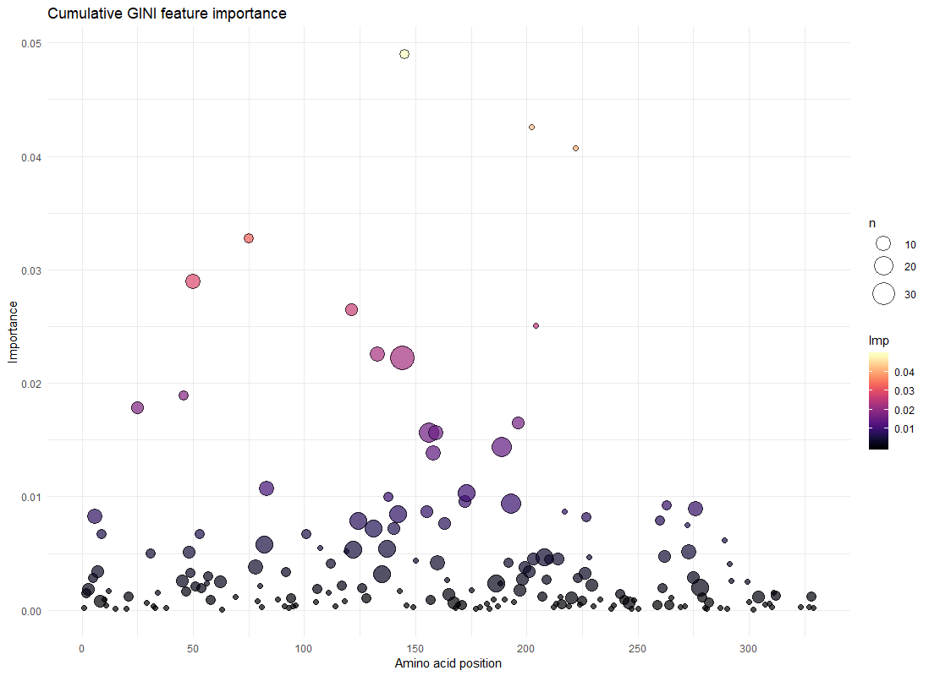
Identity not included
At 0.179… importance

Slide 7
Near ID
Far AD
Far ID
Far AD
Near ID
Near AD
Far ID
Near AD

Slide 8
Flu32 Strain Overview
 | Near predicted AU < 2AU (NA) | Far predicted AU > 4AU (FA)
Near identity > 95% (NI) | A/swine/Indiana/A02430356/2019|2010.2 Referenced to A/Hong Kong/4801/2014 96.0% id, 1.44AU A/swine/Oklahoma/A02218159/2017|2010.2 Referenced to A/Hong Kong/4801/2014 97.9% id, 1.77AU | A/swine/North Carolina/A02219753/2017|cluster_ivb Referenced to A/Swine/Minnesota/A01280592/2013 97.1% id, 5.25AU
Far identity < 93% (FI) | A/swine/Iowa/A01729543/2016|cluster_iva Referenced to A/Beijing/32/1992 85.7% id, 1.34AU | A/swine/Virginia/A02478738/2019|hu-like Referenced to A/swine/Iowa/A01729543/2016 83.4% id, 7.26AU
Abbreviations for identity and antigenic distances will be used from here on out. Example: NIFA = Near Identity Far Antigenic (distance)

Slide 9
A/swine/Indiana/A02430356/2019 NINA
a02430356|2019-02-14|2010.2 qkipgdddstatlclghhavpngtivktitndrievtnatelvqnssigeicdsphhvld
a/hongkong/4801/2014 qkipgndnstatlclghhavpngtivktitndrievtnatelvqnssigeicdsphqild
*****:*:************************************************::**
a02430356|2019-02-14|2010.2 genctlidallgdpqcdgfqnkkwdlfversraysncypydvpdyaslrslvassgtlef
a/hongkong/4801/2014 genctlidallgdpqcdgfqnkkwdlfverskaysncypydvpdyaslrslvassgtlef
*******************************:****************************
a02430356|2019-02-14|2010.2 enesfnwtgvtqngkssscirrssssffsrlnwlthlnytypalnvtmpnkehfdklyiw
a/hongkong/4801/2014 nnesfnwtgvtqngtssacirrssssffsrlnwlthlnytypalnvtmpnneqfdklyiw
:*************.**:********************************:*:*******
a02430356|2019-02-14|2010.2 gvhhpgtdndqiflyarssgritvstkrsqqavipnigsrprirdipsrisiywtivkpg
a/hongkong/4801/2014 gvhhpgtdkdqiflyaqssgritvstkrsqqavipnigsrprirdipsrisiywtivkpg
********:*******:*******************************************
a02430356|2019-02-14|2010.2 dillinstgnliaprgyfkirsgkssimrsdapigkcksecitpngsipndkpfqnvnri
a/hongkong/4801/2014 dillinstgnliaprgyfkirsgkssimrsdapigkcksecitpngsipndkpfqnvnri
************************************************************
a02430356|2019-02-14|2010.2 tygacpryvkqstlklatgmrnvpekqtr
a/hongkong/4801/2014 tygacpryvkhstlklatgmrnvpekqtr
**********:******************
13 AA Differences
4 AA changes not accounted for
N6D
N8D
Q57H
I58V
K62R
N121E
T135K
A138S
N171K
Q173H
K189N
Q197R
H311Q

Slide 10
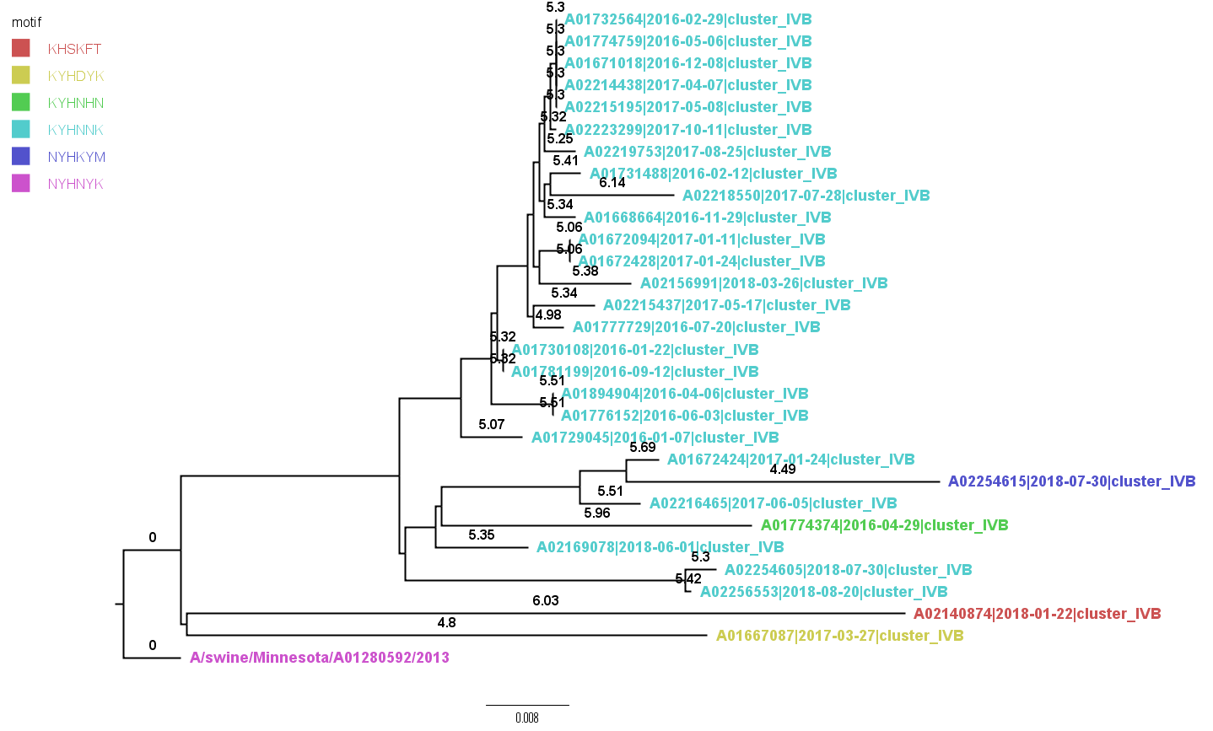
A/swine/North_Carolina/A02219753/2017 NIFA

Slide 11
A/swine/North_Carolina/A02219753/2017 NIFA
A/swine/Minnesota/A01280592/2013 QKLPGSDNSMATLCLGHHAVPNGTLVKTITDDQIEVTNATELVQSSSTGRICSSPHQILD
A02219753|2017-08-25|cluster_IVB QKLPGSDNSMATLCLGHHAVPNGTLVKTITDDQIEVTNATELVQSSSTGRICSSPHQILD
************************************************************
A/swine/Minnesota/A01280592/2013 GKNCTLIDALLGDPHCDDFQNREWDLFVERSTAYSNCYPYYVPDYASLRSLVASSGTLEF
A02219753|2017-08-25|cluster_IVB GKNCTLIDALLGDPHCDDFQNKKWDLFVERSTAYSNCYPYYVPDYASLRSLVASSGTLEF
*********************.:*************************************
A/swine/Minnesota/A01280592/2013 TQESFNWTGVAQDGSSYACRRESDNSFFSRLNWLYHLNYKYPALNVTMPNNDKFDKLYIW
A02219753|2017-08-25|cluster_IVB TQESFNWTGVAQDGSSNACRRESNKSFFSRLNWLYHLNNKYPALNVTMPNNDKFDKLYVW
**************** ******::************* *******************:*
A/swine/Minnesota/A01280592/2013 GVHHPGTDKDQTNLYVQASGRVTVSTKRSQQTVIPNVGSRPWVRGVSSIISIYWTIVKPG
A02219753|2017-08-25|cluster_IVB GVHHPGTDKDQTYLYVQAPGRVTISTRRSQQTVIPNVGSRPWVRGVSSIISIYWTIVKPG
************ *****.****:**.*********************************
A/swine/Minnesota/A01280592/2013 DILLINSTGNLIAPRGYFKIQSGKSSIMRSDAPIDNCNSECITPNGSIPNDKPFQNVNRI
A02219753|2017-08-25|cluster_IVB DILLINSTGNLIAPRGYFKIQSGKSSIMRSDAPIDNCDSECITPNGNIPNDKPFQNVNRI
*************************************:********.*************
A/swine/Minnesota/A01280592/2013 TYGACPRYVKQNTLKLATGMRNVPEKQTR
A02219753|2017-08-25|cluster_IVB TYGACPRYVKQNTLKLATGMRNVPEKQTR
*****************************
13 AA Differences
All accounted for
82RK
83EK
137YN
144DN
145NK
159YN
179IV
193NY
199SP
204VI
207KR
278ND
287SN

Slide 12
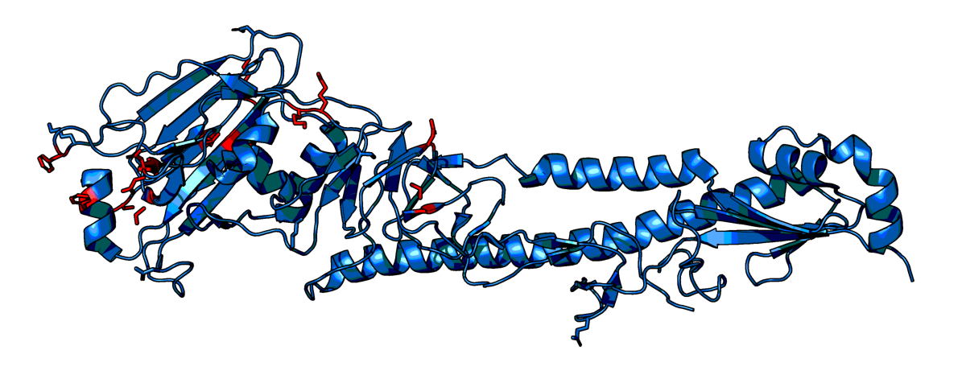
A/swine/North_Carolina/A02219753/2017 NIFA
207
83
179
145
82
159
204
199
278
193
144
287
137
Vic/361/2011

Slide 13
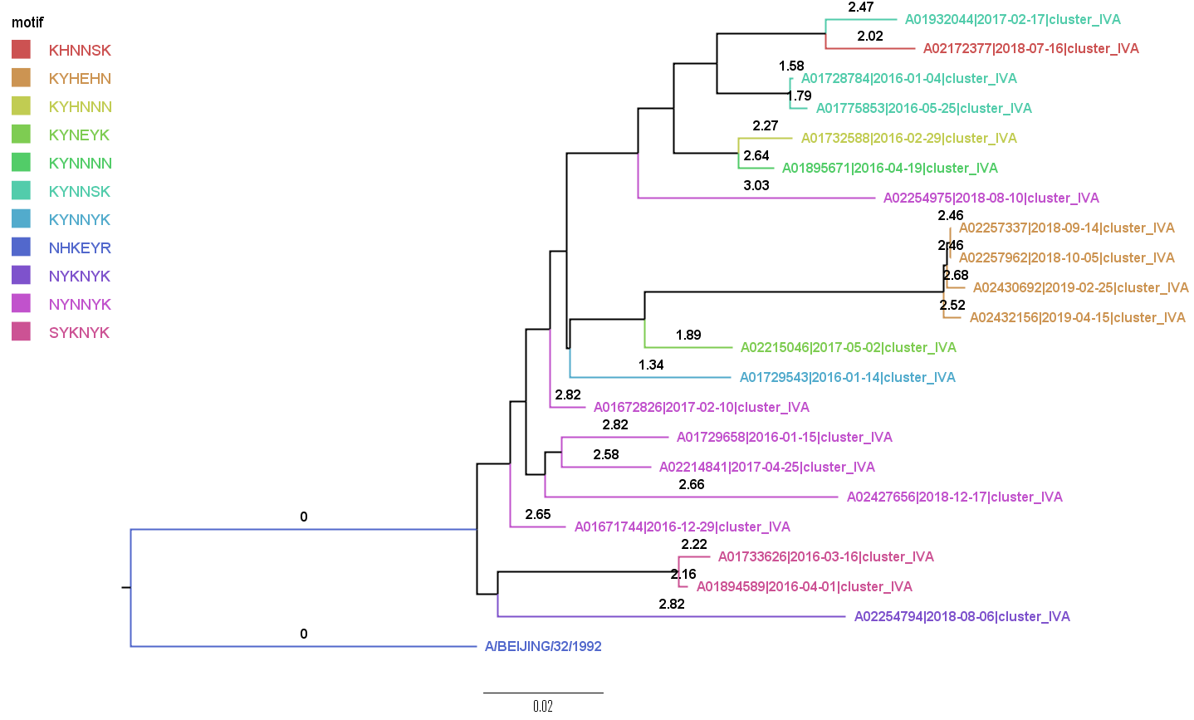
A/swine/Iowa/A01729543/2016 FINA

Slide 14
A/swine/Iowa/A01729543/2016 FINA
A/BEIJING/32/1992 QKLPGNDNSTATLCLGHHAVPNGTLVKTITNDQIEVTNATELVQSSSTGRICDSPHRILD
A01729543|2016-01-14|cluster_IVA QKLPGSDNSMATLCLGHHAVPNGTLVKTLTDDQIEVTNATELVQSSSTGRICNSPHQILD
*****.*** ******************:*:*********************:***.***
A/BEIJING/32/1992 GKNCTLIDALLGDPHCDGFQNKEWDLFVERSKAYSNCYPYDVPDYASLRSLVASSGTLEF
A01729543|2016-01-14|cluster_IVA GKNCTLIDALLGDPHCDDFQNKEWDLFVERSTAYSNCYPYYVPDYATLRSIVASSGSLEF
*****************.*************.******** *****:***:*****:***
A/BEIJING/32/1992 INEDFNWTGVAQDGGSYACKRGSVNSFFSRLNWLHKSEYKYPALNVTMPNNGKFDKLYIW
A01729543|2016-01-14|cluster_IVA TQESFNWTGVSQDGSSHACRRGSVKSFFSRLNWLYNLNYKYPEQNVTMPNNDKFDKLYIW
:*.******:***.*:**.****:*********:: :**** *******.********
A/BEIJING/32/1992 GVHHPSTDRDQTSLYVRASGRVTVSTKRSQQTVTPNIGSRPWVRGQSSRISIYWTIVKPG
A01729543|2016-01-14|cluster_IVA GVHHPGTDKDQTNLYVQASGRVIVSTKRGQQTVIPSIGSRPWVKGVSSIISIYWTIVKPG
*****.**.***.***.***** *****.**** *.*******.* ** ***********
A/BEIJING/32/1992 DILLINSTGNLIAPRGYFKIRNGKSSIMRSDAPIGTCSSECITPNGSIPNDKPFQNVNRI
A01729543|2016-01-14|cluster_IVA DILVINSTGNLIAPRGYFKIQSGKSSIMRSDAHIDECNSECITPNGSISNDKPFQNVNKI
***:****************..********** *. *.**********.*********.*
A/BEIJING/32/1992 TYGACPRYVKQNTLKLATGMRNVPEKQTR
A01729543|2016-01-14|cluster_IVA TYGACPRYVKQNTLKLATGMRNVPEKQTR
*****************************
47 AA changes
All changes accounted for
6NS
10TM
29IL
31ND
53DN
57RQ
78GD
92KT
101DY
107ST
111LI
117TS
121IT
122NQ
124DS
131AS
135GS
137YH
140KR
145NK
155HY
156KN
157SL
158EN
163AE
164LQ
172GD
186SG
189RK
193SN
197RQ
203TI
209SG
214TI
216NS
224RK
226QV
229RI
244LV
261RQ
262NS
273PH
275GD
276TE
278SN
289PS
299RK

Slide 15
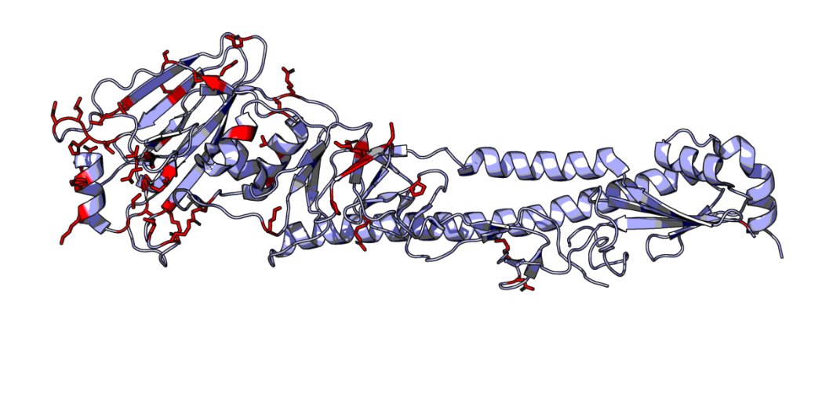
A/swine/Iowa/A01729543/2016 FINA

Slide 16
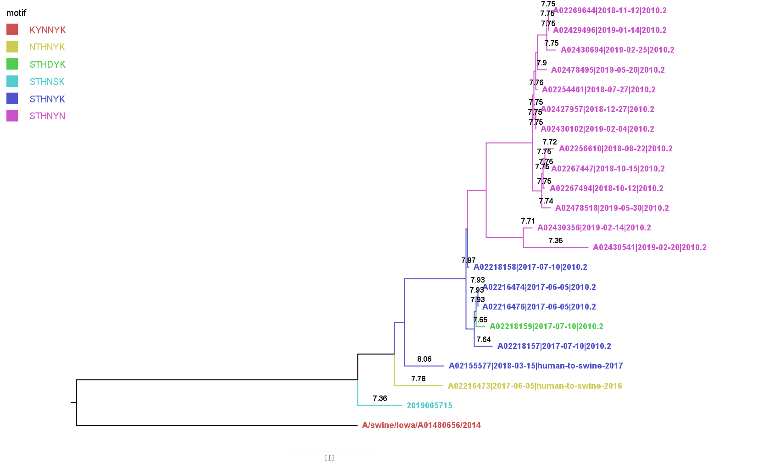
A/swine/Virginia/A02478738/2019 FIFA
C_IVA

Slide 17
A/swine/Virginia/A02478738/2019 FIFA
A/swine/Iowa/A01480656/2014 QKLPGSDNSMATLCLGHHAVPNGTLVKTITDDQIEVTNATELVQSSSTGRICNSPHQILD
2019065715 QKIPGNDNSTATLCLGHHAVPNGTIVKTITNDRIEVTNATELVQNSSIGEICDSPHQILD
**:**.*** **************:*****:*.***********.** * **:*******
A/swine/Iowa/A01480656/2014 GKNCTLIDALLGDPHCDDFQNKEWDLFVERSTAYSNCYPYYVPDYATLRSLVASSGNLEF
2019065715 GENCTLIDALLGDPQCDGFQNKKWDLFVERNKAYSNCYPYDVPDYASLRSLVASSGTLEF
*:************:**.****:*******..******** *****:*********.***
A/swine/Iowa/A01480656/2014 TQESFNWTGVAQDGSSYACRRGSVKSFFSRLNWLYNLNYKYPEQNVTMPNNDKFDKLYIW
2019065715 NNESFNWAGVTQNGTSSSCIRGSKSSFFSRLNWLTHLNSKYPALNVTMPNNEKFDKLYIW
.:*****:**:*:*:* :* *** .********* :** *** *******:********
A/swine/Iowa/A01480656/2014 GVHHPGTDKDQTNLYVQASGRVIVSTKRSQQTVIPNIGSRPWVRGVSSIISIYWTIVKPG
2019065715 GVHHPGTDKDQISLYAQSSGRITVSTKRSQQAVIPNIGSRPRIRDIPSRISIYWTIVKPG
*********** .**.*:***: ********:*********.:*.:.* ***********
A/swine/Iowa/A01480656/2014 DILLINSTGNLIAPRGYFKIQSGKSSIMRSDAHIDECNSECITPNGSISNDKPFQNVNKI
2019065715 DILLINSTGNLIAPRGYFKIRSGKSSIMRSDAPIGKCKSECITPNGSIPNDKPFQNVNRI
********************.*********** *.:*:**********.*********.*
A/swine/Iowa/A01480656/2014 TYGACPRYVKQNTLKLATGMRNVPEKQTR
2019065715 TYGACPRYVKQSTLKLATGMRNVPERQTR
***********.*************.***
58 AA changes
57 accounted for
3LI
6SN
10MT
25LI
31DN
33QR
45SN
48TI
50RE
53ND
62KE
75HQ
78DG
83EK
91SN
92TK
101YD
107TS
117NT
121TN
122QN
128TA
131AT
133DN
135ST
137YS
138AS
140RI
144VK
145KS
155YT
156NH
159YS
163EA
164QL
172DE
192TI
193NS
196VA
198AS
202VI
203IT
212TA
222WR
223VI
225GD
226VI
227SP
229IR
261QR
273HP
275DG
276EK
278NK
289SP
299KR
312NS
326KR

Slide 18
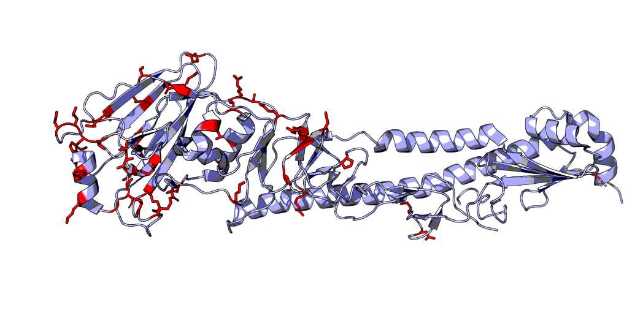
A/swine/Virginia/A02478738/2019 FIFA

Slide 19
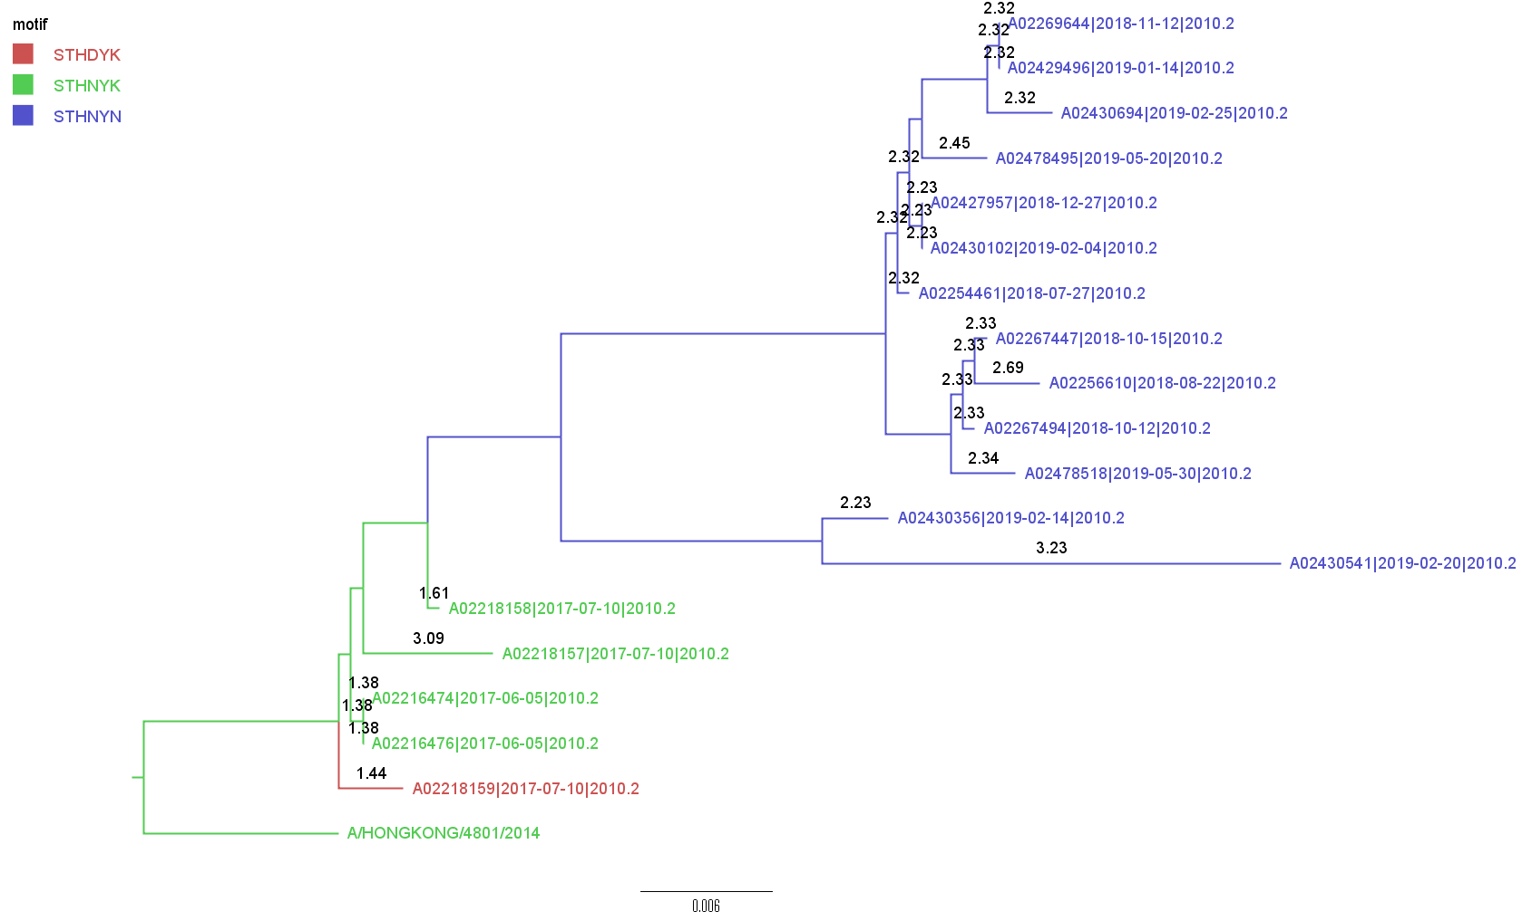
A/swine/Oklahoma/A02218159/2017 NINA

Slide 20
A/swine/Oklahoma/A02218159/2017 NINA
A/HONGKONG/4801/2014 QKIPGNDNSTATLCLGHHAVPNGTIVKTITNDRIEVTNATELVQNSSIGEICDSPHQILD
A02218159|2017-07-10|2010.2 QKIPGNDNSTATLCLGHHAVPNGTIVKTITNDRIEVTNATELVQNSSIGEICDSPHQVLD
*********************************************************:**
A/HONGKONG/4801/2014 GENCTLIDALLGDPQCDGFQNKKWDLFVERSKAYSNCYPYDVPDYASLRSLVASSGTLEF
A02218159|2017-07-10|2010.2 GENCTLIDALLGDPQCDGFQNKKWDLFVERSRAYSNCYPYDVPDYASLRSLVASSGTLEF
*******************************.****************************
A/HONGKONG/4801/2014 NNESFNWTGVTQNGTSSACIRRSSSSFFSRLNWLTHLNYTYPALNVTMPNNEQFDKLYIW
A02218159|2017-07-10|2010.2 KNESFNWTGVTQNGTSSACIRRSSSSFFSRLNWLTHLDYTYPALNVTMPNKEQFDKLYIW
:************************************:************:*********
A/HONGKONG/4801/2014 GVHHPGTDKDQIFLYAQSSGRITVSTKRSQQAVIPNIGSRPRIRDIPSRISIYWTIVKPG
A02218159|2017-07-10|2010.2 GVHHPGTDKDQIFLYARSSGRITVSTKRSQQAVIPNIGSRPRIRDIPSRISIYWTIVKPG
****************.*******************************************
A/HONGKONG/4801/2014 DILLINSTGNLIAPRGYFKIRSGKSSIMRSDAPIGKCKSECITPNGSIPNDKPFQNVNRI
A02218159|2017-07-10|2010.2 DILLINSTGNLIAPRGYFKIRSGKSSIMRSDAPIGKCKSECITPNGSIPNDKPFQNVNRI
************************************************************
A/HONGKONG/4801/2014 TYGACPRYVKHSTLKLATGMRNVPEKQTR
A02218159|2017-07-10|2010.2 TYGACPRYVKQSTLKLATGMRNVPEKQTR
**********:******************
7 AA changes
All changes accounted for
58IV
92KR
121NK
158ND
171NK
197QR
311HQ

Slide 21
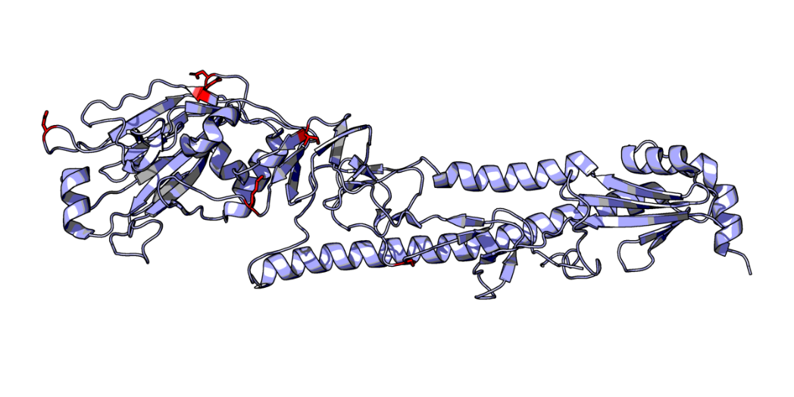
A/swine/Oklahoma/A02218159/2017 NINA
121
171
158
58
197
92
311
Vic/361/2011

Slide 22
Flu32B
This study used raw HI data for prediction.

Slide 23
Feature Importance Index by position (seed = 777)
identity | 0.31 | 11at | 0.00 | 49dg | 0.00 | 78de | 0.00 | 92kt | 0.00 | 122qt | 0.00 | 131dt | 0.00 | 137sy | 0.00 | 142rs | 0.00 | 144gk | 0.00 | 156hr | 0.00 | 160kq | 0.00 | 173kq | 0.00 | 189kn | 0.00 | 193an | 0.00 | 202iv | 0.05 | 215ps | 0.00 | 229gv | 0.00 | 264kr | 0.00 | 278dn | 0.00 | 312ns | 0.00
1qr | 0.00 | 15lr | 0.00 | 49ds | 0.00 | 78eg | 0.00 | 92kr | 0.00 | 122pq | 0.00 | 131st | 0.00 | 137ny | 0.00 | 142gn | 0.00 | 144ds | 0.00 | 156es | 0.00 | 160ak | 0.00 | 173kr | 0.00 | 189rs | 0.00 | 193ay | 0.00 | 203it | 0.00 | 216ns | 0.00 | 230iv | 0.00 | 264kn | 0.00 | 278sy | 0.00 | 312ks | 0.00
2kn | 0.00 | 20gv | 0.00 | 50gr | 0.01 | 78gn | 0.00 | 92rt | 0.00 | 122nt | 0.00 | 131nt | 0.00 | 137hs | 0.00 | 142ks | 0.00 | 144ai | 0.00 | 156nr | 0.00 | 160at | 0.00 | 173nq | 0.00 | 189nr | 0.00 | 193af | 0.00 | 203at | 0.00 | 216dn | 0.00 | 233hy | 0.00 | 264nr | 0.00 | 278in | 0.00 | 323iv | 0.00
2dn | 0.00 | 21ps | 0.00 | 50er | 0.00 | 78ds | 0.00 | 93at | 0.00 | 122np | 0.00 | 131ds | 0.00 | 137hy | 0.00 | 142es | 0.00 | 144ak | 0.00 | 156rs | 0.00 | 160ar | 0.00 | 173nr | 0.00 | 189er | 0.00 | 193kr | 0.00 | 203ai | 0.00 | 216ds | 0.00 | 238kr | 0.00 | 265gs | 0.00 | 278ks | 0.00 | 326kr | 0.00
2dk | 0.00 | 21pq | 0.00 | 50eg | 0.00 | 78en | 0.00 | 94fy | 0.00 | 122dt | 0.00 | 131de | 0.00 | 137cs | 0.00 | 142nr | 0.00 | 144ei | 0.00 | 156qr | 0.00 | 160qr | 0.00 | 173dk | 0.00 | 189ns | 0.00 | 193ar | 0.00 | 203iv | 0.00 | 217iv | 0.00 | 239ps | 0.00 | 269kr | 0.00 | 278ik | 0.00 | 327qr | 0.00
3il | 0.00 | 21qs | 0.00 | 50kr | 0.00 | 78gs | 0.00 | 94hy | 0.00 | 122pt | 0.00 | 131ns | 0.00 | 137rs | 0.00 | 142kn | 0.00 | 144is | 0.00 | 156er | 0.00 | 160rt | 0.00 | 173qr | 0.00 | 189kq | 0.00 | 193ky | 0.00 | 203tv | 0.00 | 219fs | 0.00 | 242im | 0.00 | 271dn | 0.00 | 278is | 0.00 | 328nt | 0.00
3lr | 0.00 | 25il | 0.02 | 50ek | 0.00 | 78es | 0.00 | 94fh | 0.00 | 122dp | 0.00 | 131en | 0.00 | 137cy | 0.00 | 142en | 0.00 | 144gs | 0.00 | 157ls | 0.00 | 160qt | 0.00 | 173dq | 0.00 | 189gs | 0.00 | 193ak | 0.00 | 203av | 0.00 | 220rv | 0.00 | 242iv | 0.00 | 272av | 0.00 | 278dy | 0.00 | 328it | 0.00
3fl | 0.00 | 25ls | 0.00 | 50gk | 0.00 | 79fl | 0.00 | 95ns | 0.00 | 124gs | 0.00 | 131dn | 0.00 | 137ns | 0.00 | 142ns | 0.00 | 144es | 0.00 | 157lm | 0.00 | 160aq | 0.00 | 173dn | 0.00 | 189es | 0.00 | 194il | 0.00 | 204iv | 0.00 | 220rs | 0.00 | 244fl | 0.00 | 273hp | 0.00 | 278ky | 0.00 | 329kr | 0.00
3fi | 0.00 | 25fl | 0.00 | 51im | 0.00 | 80kq | 0.00 | 96dn | 0.00 | 124ds | 0.00 | 131es | 0.00 | 137nr | 0.00 | 143ps | 0.00 | 144as | 0.00 | 157ms | 0.00 | 163av | 0.00 | 175dn | 0.00 | 189gk | 0.00 | 196av | 0.00 | 207kr | 0.00 | 220kr | 0.00 | 244lv | 0.00 | 273ps | 0.00 | 278dk | 0.00
3ir | 0.00 | 25fi | 0.00 | 51il | 0.00 | 81dn | 0.00 | 101dy | 0.01 | 124ns | 0.00 | 131et | 0.00 | 137hr | 0.00 | 144gv | 0.00 | 145kn | 0.08 | 158gn | 0.00 | 163ae | 0.00 | 177lm | 0.00 | 189nq | 0.00 | 196iv | 0.00 | 207kq | 0.00 | 220ir | 0.00 | 244fv | 0.00 | 273hs | 0.00 | 278ds | 0.00
3fr | 0.00 | 25is | 0.00 | 53dn | 0.00 | 82kr | 0.00 | 101df | 0.00 | 124dg | 0.00 | 133dn | 0.01 | 137ch | 0.00 | 144nv | 0.00 | 145ks | 0.00 | 158kn | 0.00 | 163at | 0.00 | 179iv | 0.00 | 189qr | 0.00 | 196tv | 0.00 | 207qr | 0.00 | 220sv | 0.00 | 246ns | 0.00 | 273hq | 0.00 | 278di | 0.00
5eg | 0.00 | 29il | 0.00 | 53ns | 0.00 | 82kt | 0.00 | 101fy | 0.00 | 124is | 0.00 | 133dg | 0.01 | 137fy | 0.00 | 144dv | 0.00 | 145ns | 0.00 | 158dn | 0.00 | 163ev | 0.00 | 182iv | 0.00 | 189gn | 0.00 | 196ai | 0.00 | 208rw | 0.00 | 220is | 0.00 | 246nt | 0.00 | 273pq | 0.00 | 278iy | 0.00
5gr | 0.00 | 31dn | 0.00 | 53ds | 0.00 | 82ek | 0.00 | 105hy | 0.00 | 124dn | 0.00 | 133ns | 0.00 | 137cn | 0.00 | 144iv | 0.00 | 146gs | 0.00 | 158en | 0.00 | 163et | 0.00 | 183hl | 0.00 | 189gr | 0.00 | 196at | 0.00 | 208rs | 0.00 | 220ks | 0.00 | 246st | 0.00 | 273lp | 0.00 | 279fs | 0.00
5er | 0.00 | 31dg | 0.00 | 54rs | 0.00 | 82kn | 0.00 | 106as | 0.00 | 124di | 0.00 | 133gn | 0.00 | 137fn | 0.00 | 144ns | 0.00 | 149gs | 0.00 | 158ek | 0.00 | 163tv | 0.00 | 185pt | 0.00 | 189en | 0.00 | 196it | 0.00 | 208ks | 0.00 | 222rw | 0.06 | 247rs | 0.00 | 273hl | 0.00 | 279ls | 0.00
6ns | 0.00 | 31gn | 0.00 | 54ns | 0.00 | 82rt | 0.00 | 106av | 0.00 | 124gi | 0.00 | 133de | 0.00 | 137fs | 0.00 | 144kn | 0.00 | 150kr | 0.00 | 158de | 0.00 | 164lq | 0.00 | 186gs | 0.00 | 189qs | 0.00 | 197qr | 0.00 | 208kr | 0.00 | 223iv | 0.00 | 248it | 0.00 | 273qs | 0.00 | 279fl | 0.00
6in | 0.00 | 32de | 0.00 | 54nr | 0.00 | 82ak | 0.00 | 106sv | 0.00 | 124gn | 0.00 | 133ds | 0.00 | 137cr | 0.00 | 144av | 0.00 | 155hy | 0.00 | 158dg | 0.00 | 165ns | 0.00 | 186iv | 0.00 | 189eq | 0.00 | 197hq | 0.00 | 208gs | 0.00 | 223av | 0.00 | 248nt | 0.00 | 273ls | 0.00 | 280ae | 0.00
6gn | 0.00 | 33qr | 0.00 | 56hy | 0.00 | 82en | 0.00 | 107st | 0.00 | 124dr | 0.00 | 133gs | 0.00 | 137hn | 0.00 | 144kv | 0.00 | 155ny | 0.00 | 158gk | 0.00 | 165kn | 0.00 | 186eg | 0.00 | 189eg | 0.00 | 197kq | 0.00 | 208gr | 0.00 | 223ai | 0.00 | 248in | 0.00 | 273lq | 0.00 | 281cf | 0.00
6gs | 0.00 | 34iv | 0.00 | 57qr | 0.00 | 82at | 0.00 | 111il | 0.00 | 124gr | 0.00 | 133eg | 0.00 | 137fh | 0.00 | 144ad | 0.00 | 155ht | 0.00 | 158dk | 0.00 | 165en | 0.00 | 186sv | 0.00 | 189gq | 0.00 | 197kr | 0.00 | 208ir | 0.00 | 224kr | 0.00 | 250dn | 0.00 | 275dg | 0.00 | 282it | 0.00
6is | 0.00 | 38ns | 0.00 | 57kr | 0.00 | 82nr | 0.00 | 112iv | 0.00 | 124rs | 0.00 | 133en | 0.00 | 137cf | 0.00 | 144sv | 0.00 | 155ty | 0.00 | 158eg | 0.00 | 165ek | 0.00 | 186gv | 0.00 | 190de | 0.00 | 197hr | 0.00 | 208sw | 0.00 | 225gn | 0.00 | 259kq | 0.00 | 275ds | 0.00 | 282iv | 0.00
6nr | 0.00 | 45ns | 0.00 | 57kq | 0.00 | 82ar | 0.00 | 112av | 0.00 | 124ir | 0.00 | 133es | 0.00 | 137fr | 0.00 | 144an | 0.00 | 155hn | 0.00 | 159hy | 0.01 | 165es | 0.00 | 186is | 0.00 | 192it | 0.00 | 198as | 0.00 | 208is | 0.00 | 225dg | 0.00 | 259qr | 0.00 | 275gs | 0.00 | 282tv | 0.00
6rs | 0.00 | 45gs | 0.00 | 58iv | 0.00 | 82nt | 0.00 | 112ai | 0.00 | 124nr | 0.00 | 135st | 0.00 | 138as | 0.00 | 144de | 0.00 | 155nt | 0.00 | 159sy | 0.00 | 167at | 0.00 | 186ag | 0.00 | 192at | 0.00 | 198ae | 0.00 | 208gw | 0.00 | 225dn | 0.00 | 259kr | 0.00 | 275de | 0.00 | 287ns | 0.00
6gr | 0.00 | 45gn | 0.00 | 58il | 0.00 | 82et | 0.00 | 114as | 0.00 | 124in | 0.00 | 135gt | 0.00 | 138at | 0.00 | 144ev | 0.00 | 156kn | 0.00 | 159fy | 0.00 | 167nt | 0.00 | 186as | 0.00 | 192ai | 0.00 | 198at | 0.00 | 208gi | 0.00 | 226iv | 0.00 | 260im | 0.00 | 275eg | 0.00 | 289ps | 0.01
6gi | 0.00 | 45is | 0.00 | 58lv | 0.00 | 82er | 0.00 | 117nt | 0.00 | 126dn | 0.00 | 135as | 0.00 | 138st | 0.00 | 144dn | 0.00 | 156hs | 0.00 | 159qs | 0.00 | 167tv | 0.00 | 186av | 0.00 | 193ns | 0.00 | 198es | 0.00 | 208gk | 0.00 | 226iq | 0.00 | 260il | 0.00 | 275es | 0.00 | 290hn | 0.00
6ir | 0.00 | 45in | 0.00 | 62ek | 0.01 | 82ae | 0.00 | 117st | 0.00 | 126nt | 0.00 | 135at | 0.00 | 140kr | 0.00 | 144in | 0.00 | 156hn | 0.00 | 159ny | 0.00 | 167an | 0.00 | 186gi | 0.00 | 193fs | 0.00 | 198st | 0.00 | 209ns | 0.00 | 226il | 0.00 | 260lm | 0.00 | 276kn | 0.00 | 291dg | 0.00
7dg | 0.00 | 45gi | 0.00 | 62ik | 0.00 | 83ek | 0.00 | 117ns | 0.00 | 126dt | 0.00 | 135gs | 0.00 | 140ik | 0.00 | 144ae | 0.00 | 156hk | 0.00 | 159fs | 0.00 | 167av | 0.00 | 186ai | 0.00 | 193rs | 0.00 | 198et | 0.00 | 209gs | 0.00 | 226qv | 0.00 | 261qr | 0.00 | 276en | 0.00 | 292kr | 0.00
7ds | 0.00 | 46fs | 0.00 | 62ei | 0.00 | 83kn | 0.00 | 118lm | 0.00 | 128nt | 0.00 | 135et | 0.00 | 140ir | 0.00 | 144en | 0.00 | 156ns | 0.00 | 159qy | 0.00 | 168mv | 0.00 | 186es | 0.00 | 193sy | 0.00 | 199ps | 0.00 | 210hq | 0.00 | 226lv | 0.00 | 261kq | 0.00 | 276ek | 0.00 | 299kr | 0.00
7de | 0.00 | 46st | 0.00 | 62kr | 0.00 | 83en | 0.00 | 119ek | 0.00 | 128it | 0.00 | 135ag | 0.00 | 140kt | 0.00 | 144ik | 0.00 | 156nq | 0.00 | 159hs | 0.00 | 169lp | 0.00 | 186ev | 0.00 | 193ny | 0.00 | 199is | 0.00 | 210qr | 0.00 | 226lq | 0.00 | 261kr | 0.00 | 276kt | 0.00 | 300iv | 0.00
8dn | 0.00 | 46ft | 0.00 | 62ir | 0.00 | 83eg | 0.00 | 121nt | 0.00 | 128at | 0.00 | 135eg | 0.00 | 140rt | 0.00 | 144dk | 0.00 | 156ks | 0.00 | 159fq | 0.00 | 171kn | 0.00 | 186ei | 0.00 | 193fn | 0.00 | 199ip | 0.00 | 210hr | 0.00 | 227ps | 0.00 | 262ns | 0.00 | 276nt | 0.00 | 302fy | 0.00
8kn | 0.00 | 47st | 0.00 | 62er | 0.00 | 83kt | 0.00 | 121it | 0.00 | 128ai | 0.00 | 135gk | 0.00 | 140it | 0.00 | 144gn | 0.00 | 156hq | 0.00 | 159fn | 0.00 | 171dn | 0.00 | 186ae | 0.00 | 193fy | 0.00 | 199as | 0.00 | 212at | 0.00 | 227st | 0.00 | 262gs | 0.00 | 276ns | 0.00 | 304av | 0.00
8ny | 0.00 | 48kt | 0.00 | 63dn | 0.00 | 83et | 0.00 | 121in | 0.00 | 128an | 0.00 | 135kt | 0.00 | 142eg | 0.00 | 144dg | 0.00 | 156ek | 0.00 | 159hn | 0.00 | 172de | 0.00 | 187st | 0.00 | 193kn | 0.00 | 199ai | 0.00 | 213iv | 0.00 | 227pt | 0.00 | 262st | 0.00 | 276et | 0.00 | 304at | 0.00
8dk | 0.00 | 48at | 0.00 | 69as | 0.00 | 83gk | 0.00 | 121kn | 0.00 | 128in | 0.00 | 135es | 0.00 | 142gk | 0.00 | 144gi | 0.00 | 156kq | 0.00 | 159fh | 0.00 | 172dg | 0.00 | 188dn | 0.00 | 193fr | 0.00 | 199ap | 0.00 | 214it | 0.00 | 228gs | 0.00 | 262nt | 0.00 | 276es | 0.00 | 304ad | 0.00
8ky | 0.00 | 48it | 0.00 | 75hq | 0.02 | 83nt | 0.00 | 121kt | 0.00 | 131ad | 0.00 | 135ae | 0.00 | 142ek | 0.00 | 144di | 0.00 | 156qs | 0.00 | 159hq | 0.00 | 172eg | 0.00 | 188de | 0.00 | 193fk | 0.00 | 201ir | 0.00 | 214is | 0.00 | 229iv | 0.00 | 262gn | 0.00 | 276ks | 0.00 | 307kr | 0.00
9ns | 0.00 | 48ai | 0.00 | 75hl | 0.00 | 83gn | 0.00 | 121ik | 0.00 | 131at | 0.00 | 135ak | 0.00 | 142gr | 0.00 | 144ag | 0.00 | 156eq | 0.00 | 159ns | 0.00 | 172dn | 0.00 | 188en | 0.00 | 193nr | 0.00 | 201kr | 0.00 | 214iv | 0.00 | 229ir | 0.00 | 262gt | 0.00 | 276st | 0.00 | 309iv | 0.00
9rs | 0.00 | 48ik | 0.00 | 75lq | 0.00 | 83gt | 0.00 | 122nq | 0.00 | 131as | 0.00 | 135ks | 0.00 | 142kr | 0.00 | 144ks | 0.00 | 156kr | 0.00 | 159nq | 0.00 | 172en | 0.00 | 189ek | 0.01 | 193ks | 0.00 | 201gr | 0.00 | 214st | 0.00 | 229gr | 0.00 | 263eg | 0.00 | 278kn | 0.00 | 310kr | 0.00
9nr | 0.00 | 48ak | 0.00 | 78dg | 0.00 | 88iv | 0.00 | 122dn | 0.00 | 131an | 0.00 | 135ek | 0.00 | 142gs | 0.00 | 144eg | 0.00 | 156eh | 0.00 | 160kr | 0.00 | 172gn | 0.00 | 189kr | 0.00 | 193as | 0.00 | 201gk | 0.00 | 214tv | 0.00 | 229rv | 0.00 | 263gr | 0.00 | 278ns | 0.00 | 311hq | 0.00
10mt | 0.00 | 49gs | 0.00 | 78dn | 0.00 | 91ns | 0.00 | 122dq | 0.00 | 131ae | 0.00 | 137ry | 0.01 | 142er | 0.00 | 144ek | 0.00 | 156en | 0.00 | 160kt | 0.00 | 173kn | 0.00 | 189ks | 0.00 | 193ry | 0.00 | 201ik | 0.00 | 214sv | 0.00 | 229gi | 0.00 | 263er | 0.00 | 278ny | 0.00 | 312kn | 0.00

Slide 24
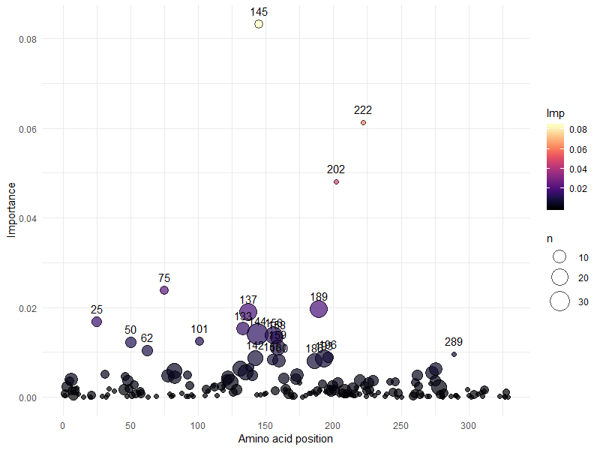
Rank of amino acid importance based on GINI
Identity at 0.312
importance

Slide 25
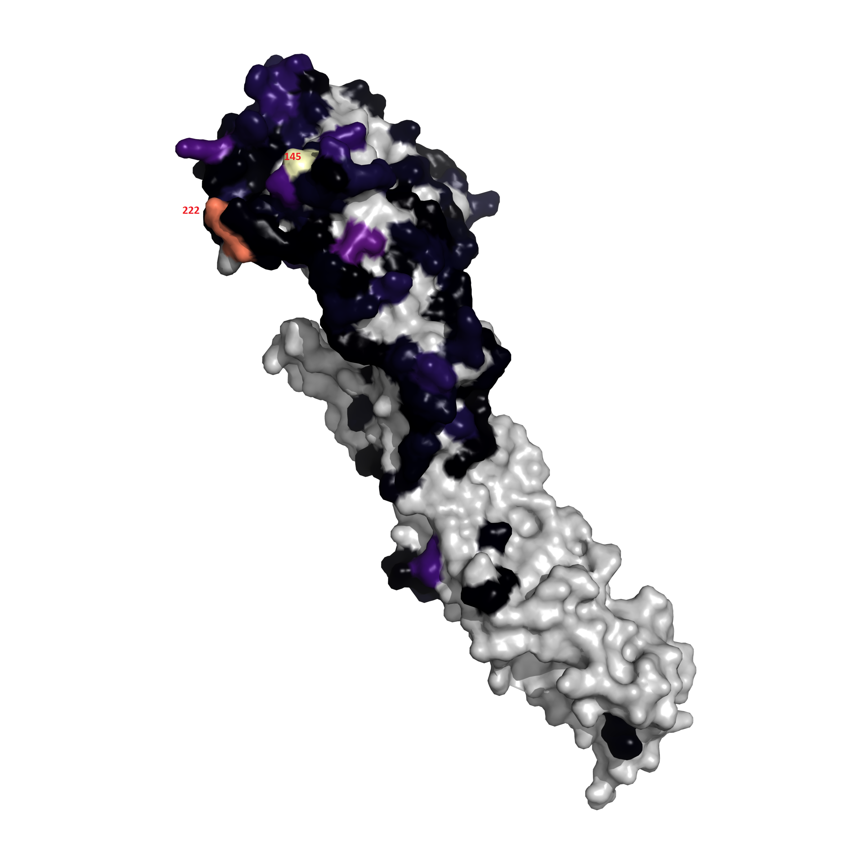
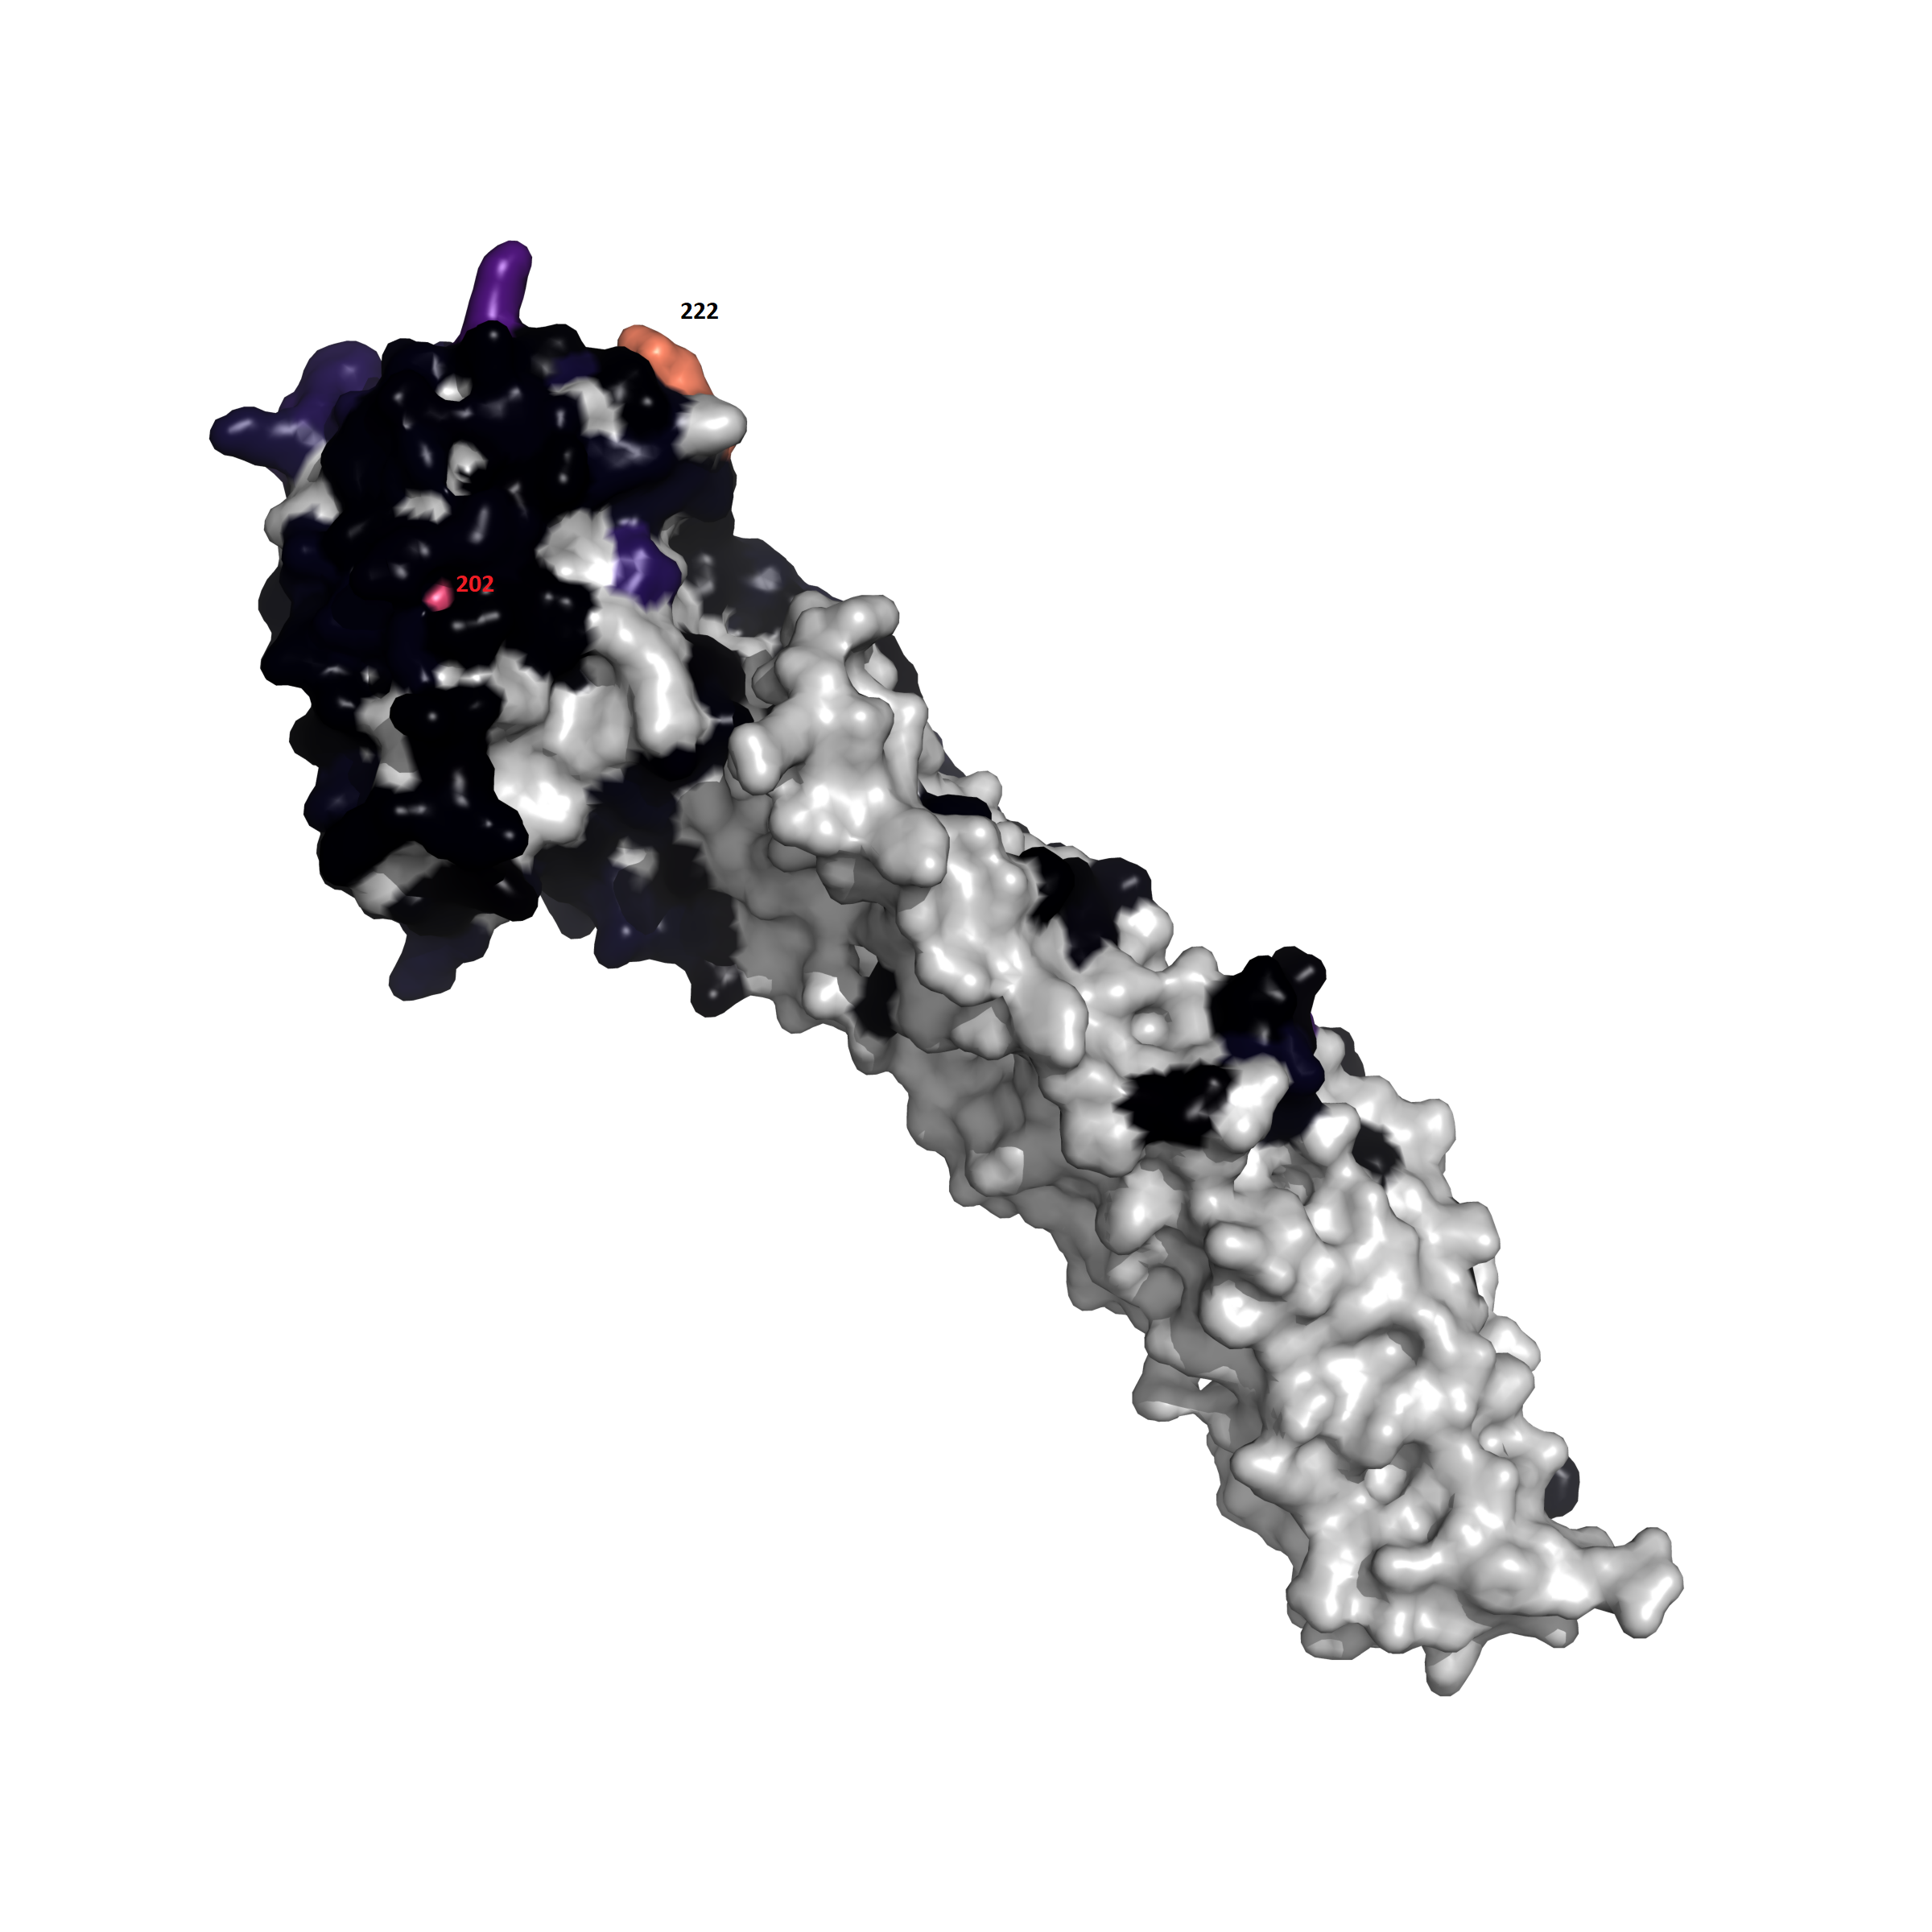
Rank of amino acid importance based on GINI

Slide 26
Near ID
Far AD
(sparse)
Far ID
Far AD
Near ID
Near AD
Far ID
Near AD

Slide 27
Flu32B overview
 | Near predicted AU < 2AU (NA) | Far predicted AU > ~4AU (FA)
Near identity > 98% (NI) | A/swine/Nebraska/A01672826/2017|C_IVA Referenced to A/swine/Indiana/a00968373/2012|C_IVA 99.1% id, 0.16 predicted AU | A/swine/Indiana/A02214844/2017|C_IVA Referenced to A/swine/Iowa/a01480656/2014|C_IVA 98.5% id, 3.30 predicted AD
Far identity < 95%, > 90% (FI) | A/swine/North_Carolina/A01732197/2016|C_IVA Referenced to A/swine/Pennsylvania/a01076777/2010 C_IV Uk % id, 0.76 predicted AD | A/swine/Iowa/A01733626/2016|C_IVA Referenced to A/swine/Indiana/a01202866/2011 C_IVC 91.2% id, 6.33 predicted AD
Abbreviations for identity and antigenic distances will be used from here on out. Example: NIFA = Near Identity Far Antigenic (distance)

Slide 28
A/swine/Nebraska/A01672826/2017 NINA
A01672826|2017-02-10|cluster_IVA QKLPGSDNSTATLCLGHHAVPNGTLVKTITDDQIEVTNATELVQSSSTGRICNSPHQILD
A/swine/Indiana/A00968373/2012 QKLPGSDNSMATLCLGHHAVPNGTLVKTITDDQIEVTNATELVQSSSTGRICNSPHQILD
********* **************************************************
A01672826|2017-02-10|cluster_IVA GKNCTLIDALLGDPHCDDFQNKEWDLFVERSTAYSNCYPYYVPDYATLRSLVASSGNLEF
A/swine/Indiana/A00968373/2012 GKNCTLIDALLGDPHCDDFQNKEWDLFVERSTAYSNCYPYYVPDYATLRSLVASSGNLEF
************************************************************
A01672826|2017-02-10|cluster_IVA TQESFNWTGVAQDGSSYACRRGSVNSFFSRLNWLYNLNYKYPEQNVTMPNNDKFDKLYIW
A/swine/Indiana/A00968373/2012 TQESFNWTGVAQDGSSYACRRGSVNSFFSRLNWLYNLNYKYPEQNVTMPNNDKFDKLYIW
************************************************************
A01672826|2017-02-10|cluster_IVA GVHHPGTDKDQTNLYVQASGRVIVSTKISQQTVIPNIGSRPWVRGVSSIISIYWTIVKPG
A/swine/Indiana/A00968373/2012 GVHHPGTDKDQTNLYVQASGRVIVSTKRSQQTVIPNIGSRPWVRGVSSIISIYWTIVKPG
*************************** ********************************
A01672826|2017-02-10|cluster_IVA DILLINSTGNLIAPRGYFKIQSGKSSIMRSDAHIDECNSECITPNGSISNDKPFQNVNKI
A/swine/Indiana/A00968373/2012 DILLINSTGNLIAPRGYFKIQSGKSSIMRSDAHIDECNSECITPNGSISNDKPFQNVNKI
************************************************************
A01672826|2017-02-10|cluster_IVA TYGACPRYVKQNTLKLATGMRNVPEKQTR
A/swine/Indiana/A00968373/2012 TYGACPRYVKQNTLKLATGMRNVPEKQTR
*****************************
2 AA changes
All changes accounted for
M10T
R208I

Slide 29
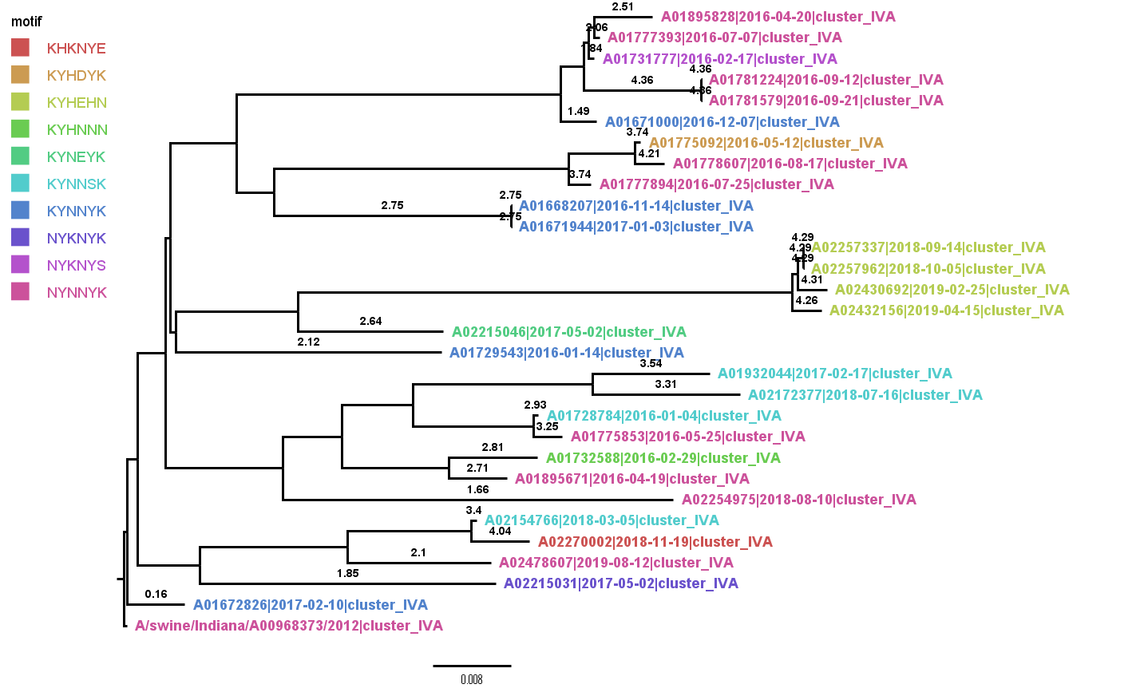
A/swine/Nebraska/A01672826/2017 NINA

Slide 30
A/swine/Indiana/A02214844/2017 NIFA
A02214844|2017-04-25|cluster_IVA QKLPGSDNSMATLCLGHHAVPNGTLVKTITDDQIEVTNATELVQSSSTSRICNSPHQILD
A/swine/Iowa/A01480656/2014 QKLPGSDNSMATLCLGHHAVPNGTLVKTITDDQIEVTNATELVQSSSTGRICNSPHQILD
************************************************.***********
A02214844|2017-04-25|cluster_IVA GKNCTLIDALLGDPHCDDFQNKKWDLFVERSTAYSNCYPYYVPDYATLRSLIASSGNLEF
A/swine/Iowa/A01480656/2014 GKNCTLIDALLGDPHCDDFQNKEWDLFVERSTAYSNCYPYYVPDYATLRSLVASSGNLEF
**********************:****************************:********
A02214844|2017-04-25|cluster_IVA TQESFNWTGVAQDGSSYACRRGSVNSFFSRLNWLYNLNYKYPEQNVTMPNNDKFDKLYIW
A/swine/Iowa/A01480656/2014 TQESFNWTGVAQDGSSYACRRGSVKSFFSRLNWLYNLNYKYPEQNVTMPNNDKFDKLYIW
************************:***********************************
A02214844|2017-04-25|cluster_IVA GVHHPGTDKDQTNLYVQASGRVIVSTKRSQQTVIPNIGSRPWVRGVSSIISIYWTIVKPG
A/swine/Iowa/A01480656/2014 GVHHPGTDKDQTNLYVQASGRVIVSTKRSQQTVIPNIGSRPWVRGVSSIISIYWTIVKPG
************************************************************
A02214844|2017-04-25|cluster_IVA DILLINSTGNLIAPRGYFKIQSGKSSIMRSDAHIDECNSECITPNGSIPNDKPFQNVNKI
A/swine/Iowa/A01480656/2014 DILLINSTGNLIAPRGYFKIQSGKSSIMRSDAHIDECNSECITPNGSISNDKPFQNVNKI
************************************************.***********
A02214844|2017-04-25|cluster_IVA TYGACPRYVKQNTLKLATGMRNVPEKQTR
A/swine/Iowa/A01480656/2014 TYGACPRYVKQNTLKLATGMRNVPEKQTR
*****************************
2 AA changes
All changes accounted for
G49S
E83K
V112I
K145N
S289P

Slide 31
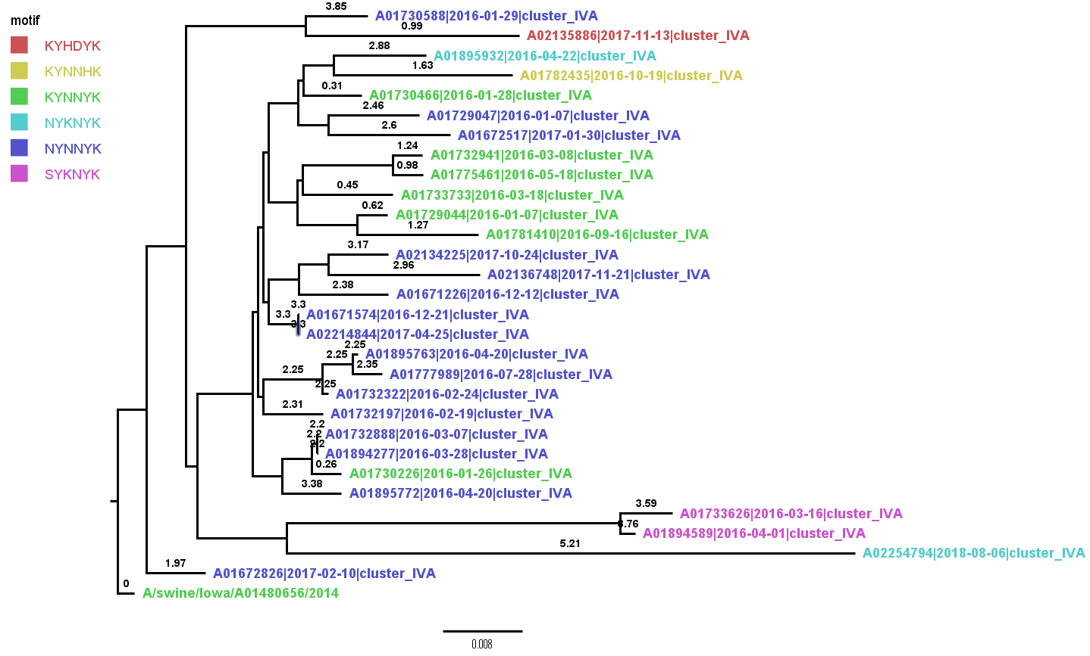
A/swine/Indiana/A02214844/2017 NIFA

Slide 32
A/swine/North_Carolina/A01732197/2016 FINA
T10M
E83K
V106S
A107T
V112I
T117N
N124S
K142S
A163E
M168V
N173K
I196V
T203I
P273H
G275D
N276E
K278N
R299K
V304A
a/swine/pennsylvania/a01076777/2010 qklpgsdnstatlclghhavpngtlvktitddqievtnatelvqssstgricnsphqild
a01732197|2016-02-19|cluster_iva qklpgsdnsmatlclghhavpngtlvktitddqievtnatelvqssstgricnsphqild
********* **************************************************
a/swine/pennsylvania/a01076777/2010 gknctlidallgdphcddfqnkewdlfverstaysncypyyvpdyvslrslvassgtlef
a01732197|2016-02-19|cluster_iva gknctlidallgdphcddfqnkkwdlfverstaysncypyyvpdyatlrsliassgnlef
**********************:**********************.:****:****.***
a/swine/pennsylvania/a01076777/2010 tqenfnwtgvaqdgssyacrrksvnsffsrlnwlynlnykypalnvtmpnndnfdklyiw
a01732197|2016-02-19|cluster_iva tqesfnwtgvaqdgssyacrrssvnsffsrlnwlynlnykypeqnvtvpnndkfdklyiw
***.*****************.******************** ***:****:*******
a/swine/pennsylvania/a01076777/2010 gvhhpgtdkdqtnlyiqasgrvtvstkrsqqtvipnigsrpwvrgvssiisiywtivkpg
a01732197|2016-02-19|cluster_iva gvhhpgtdkdqtnlyvqasgrvivstkrsqqtvipnigsrpwvrgvssiisiywtivkpg
***************:****** *************************************
a/swine/pennsylvania/a01076777/2010 dillinstgnliaprgyfkiqsgkssimrsdapigncksecitpngsipndkpfqnvnri
a01732197|2016-02-19|cluster_iva dillinstgnliaprgyfkiqsgkssimrsdahidecnsecitpngsipndkpfqnvnki
******************************** *.:*:********************:*
a/swine/pennsylvania/a01076777/2010 tygvcpryvkqntlklatgmrnvpekqtr
a01732197|2016-02-19|cluster_iva tygacpryvkqntlklatgmrnvpekqtr
***.*************************
19 AA changes
18 changes accounted for

Slide 33
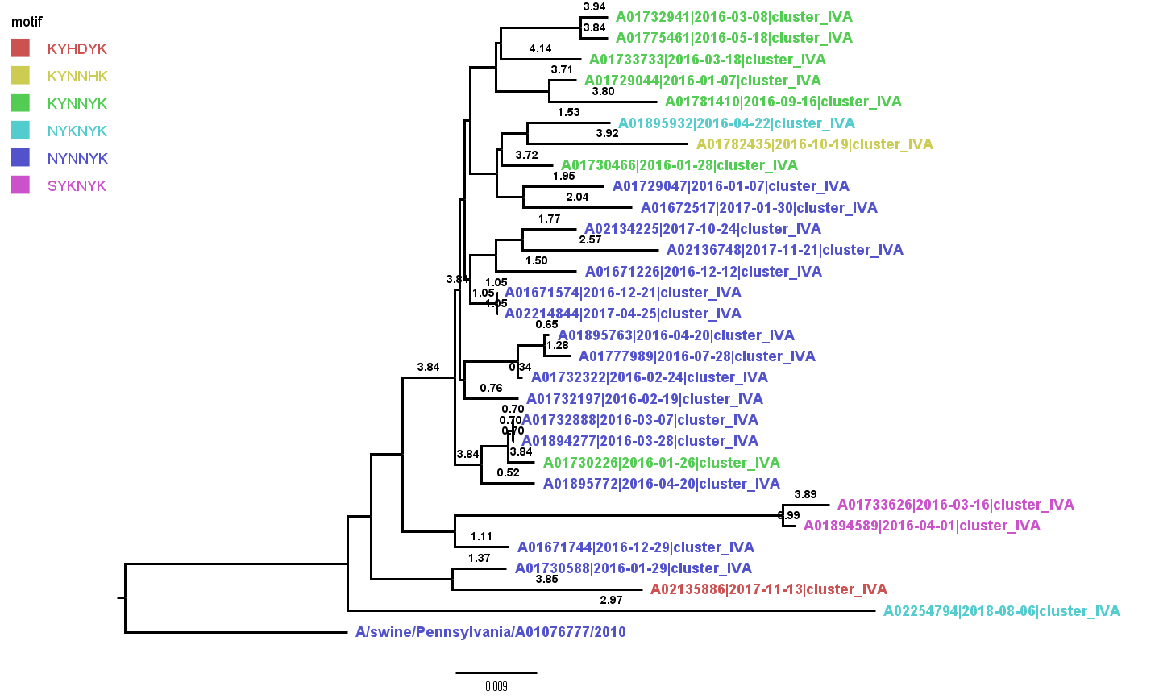
A/swine/North_Carolina/A01732197/2016 FINA

Slide 34
A/swine/Iowa/A01733626/2016 FIFA
A01733626|2016-03-16|cluster_IVA QKLPGSDNSMATLCLGHHAVPNGTLVKTLTDDQIEVTNATELVQSSSTGRICNSPHQILD
A/swine/Indiana/A01202866/2011 QKLPGSDNSMATLCLGHHAVPNGTLVKTITDDQIEVTNATELVQSSSTGGICNSPHQILD
****************************:******************** **********
A01733626|2016-03-16|cluster_IVA GKNCTLIDALLGDPHCDDFQNKKWDLFVERSTAYSNCYPYYVPDYATLRSLVASSGNLEF
A/swine/Indiana/A01202866/2011 GKNCTLIDALLGDPHCDDFQNKEWDLFVERSTAYSNCYPYYVPDYASLRSLVASSGTLEF
**********************:***********************:*********.***
A01733626|2016-03-16|cluster_IVA TQENFNWTGVDQGGSSNTCKRGSVSSFFSRLNWLYKLNYKYPEQNVAMPNNDKFDKLYIW
A/swine/Indiana/A01202866/2011 TQESFNWTGVAQDGSSRSCRRGSGNSFFSRLNWLYHLGHKYPALNVTMPNNDNFDKLYIW
***.****** *.***.:*.*** .**********:*.:*** **:*****:*******
A01733626|2016-03-16|cluster_IVA GVHHPGTDKDQTNLYAQASGRVVVSTKRSQQTVIPNIGSVPWVRGVSSIISIYWTIVKPG
A/swine/Indiana/A01202866/2011 GVHHPGTDEDQTSLYVQASGRVIVSTKRSQQTVIPNIGSRPWVRGVSSIISIYWTIVKPG
********:***.**.******:**************** ********************
A01733626|2016-03-16|cluster_IVA DILLINSTGNLIAPRGYFKIQSGKSSIMKSDAHIDECNSECITPNGSIPNDKPFQNVNKI
A/swine/Indiana/A01202866/2011 DILLINSTGNLIAPRGYFKIQSGKSSIMRSDASIDNCNSECITPNGSIPNDKPFQNVNRI
****************************.*** **:**********************.*
A01733626|2016-03-16|cluster_IVA TYGACPRYVKQNTLKLATGMRNVPEKQTR
A/swine/Indiana/A01202866/2011 TYGACPRYVKQNTLKLATGMRNVPEKQTR
*****************************
29 AA changes
All changes accounted for
I29L
G50R
E83K
S107T
T117N
S124N
A131D
D133G
R137N
S138T
R140K
G144V
N145S
H156K
G158N
H159Y
A163E
L164Q
T167A
N173K
E189K
S193N
V196A
I203V
R220V
R269K
S273H
N276E
R299K

Slide 35
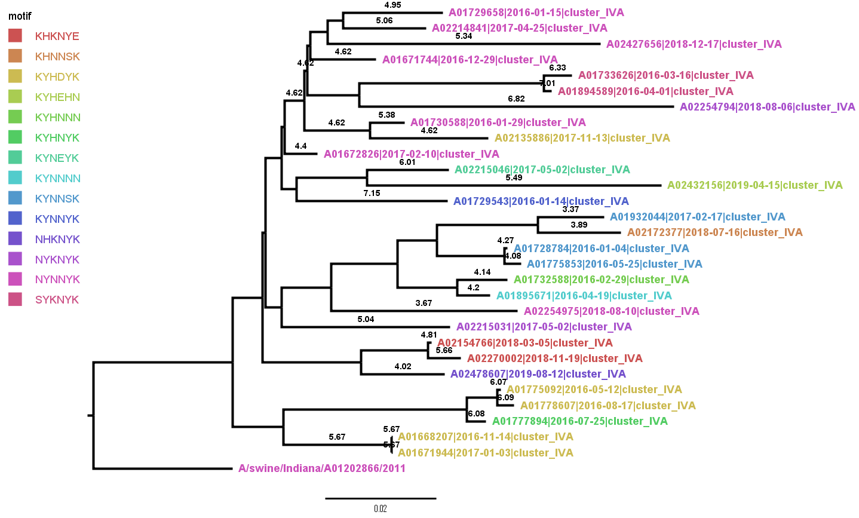
A/swine/Iowa/A01733626/2016 FIFA

